Slide 1
Bifurcation Stent Using New Generation DES
Insight from Bench Test
Yutaka HIKICHI, Koichi NODE
Department of Cardiovascular Medicine, Saga University
Saga, Japan
Kiyotaka Iwasaki, Ph.D
Waseda University, TWIns
Tokyo, Japan

Slide 2
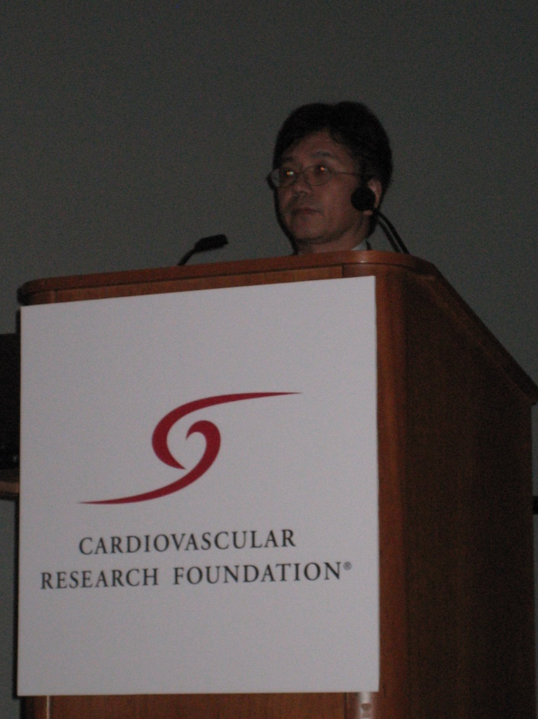
From 2003, I started micro CT testing
My first intention of Bench tests were to investigate and list up such limitations of each stents, or those stent placement techniques.
TCT 2005, Washington DC

Slide 3
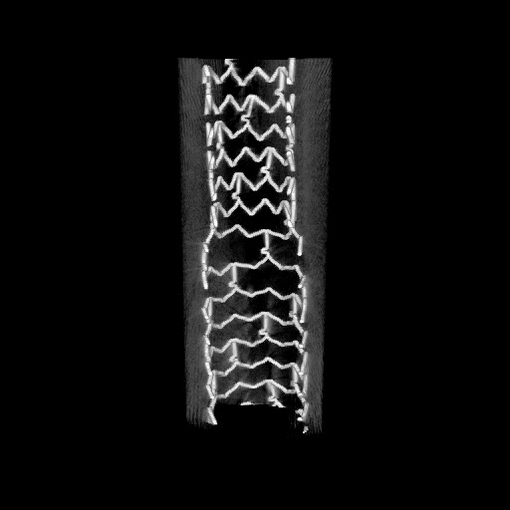
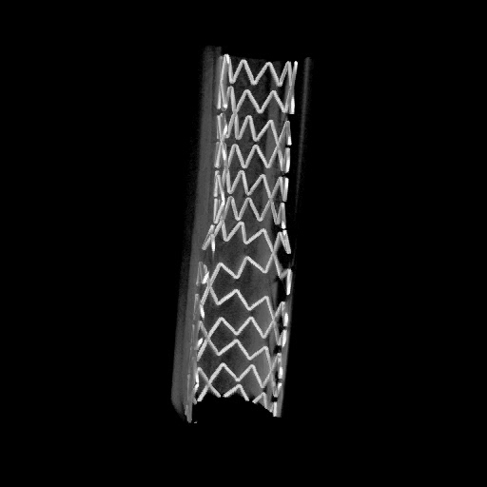
Over expansion test
Tube size:5.0mm
Stent size:3.5mm
Notes:
This is a simple medel; tube diameter is 5.0mm prximal part added post dilatation with 5.0mm high pressure
the shape of the transition point will change these image show us after the POT.

Slide 4
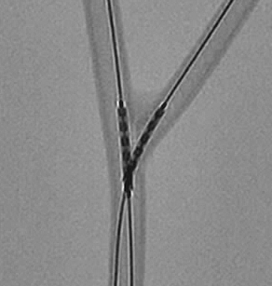
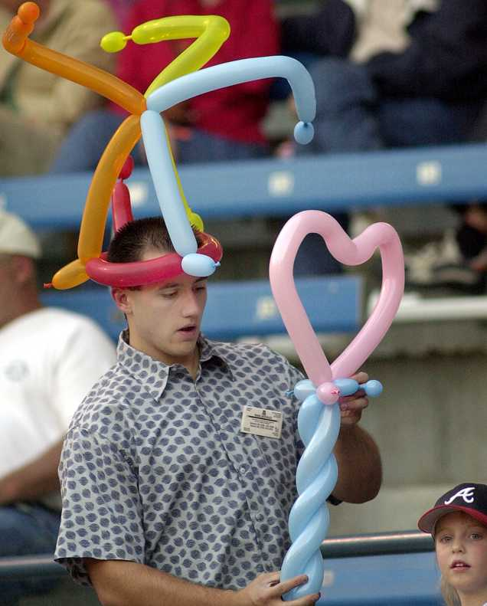
This is the Crush stenting
model1
Side branch stent implantation
18atm 60sec
Notes:
4
In this simple model, we used the crush technique. You can see the two stents overlap twisting to the bifurcation.

Slide 5
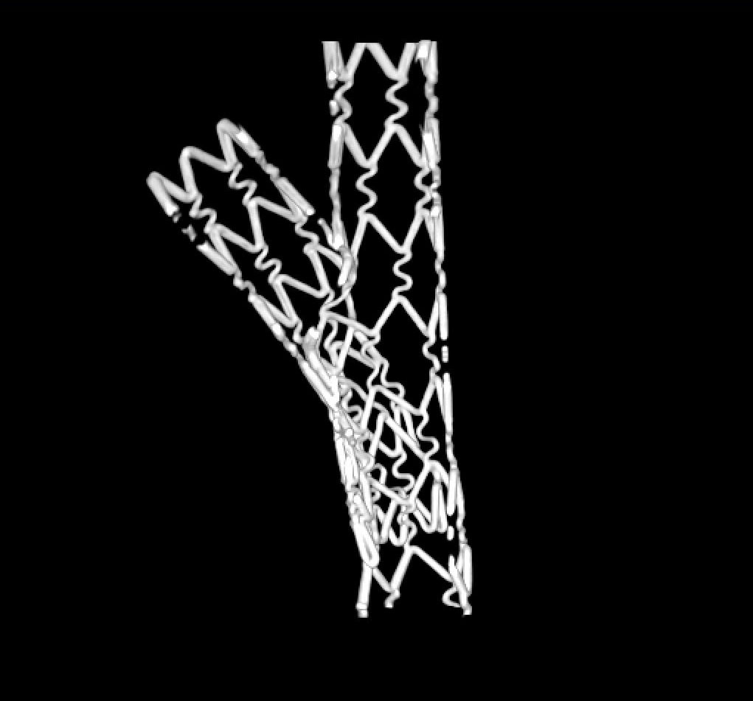
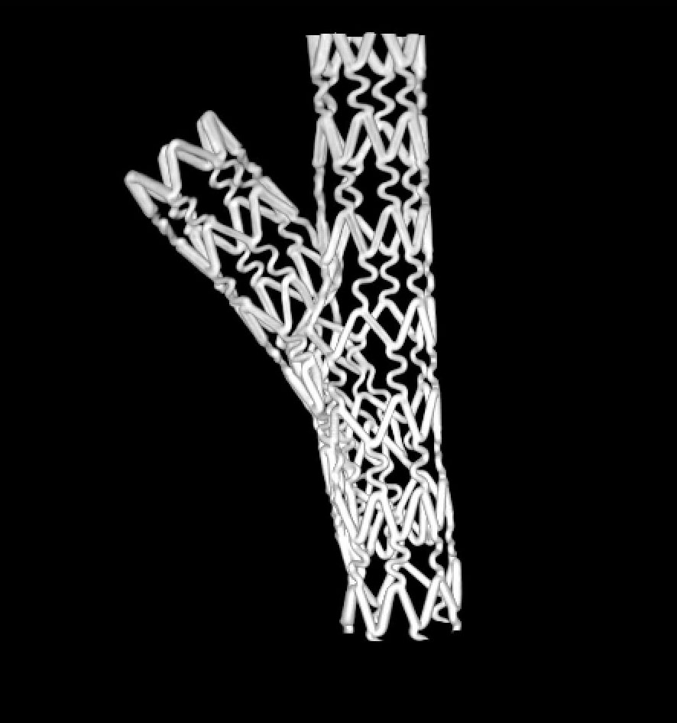
Model 1
3×3mm post KBT
3 layer
Notes:
5
This slide shows the three dimensional CT taken from the previous stent model. Also, we digitally cut the stent in half, longitudinally. We notice that there are three layers of metal in the proximal portion of the bifurcated model.

Slide 6
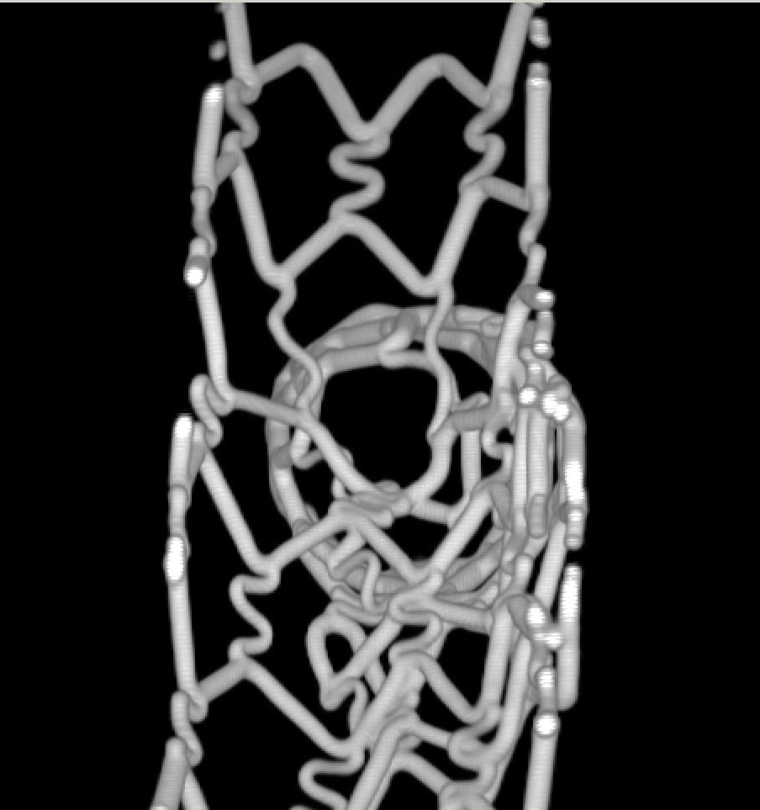
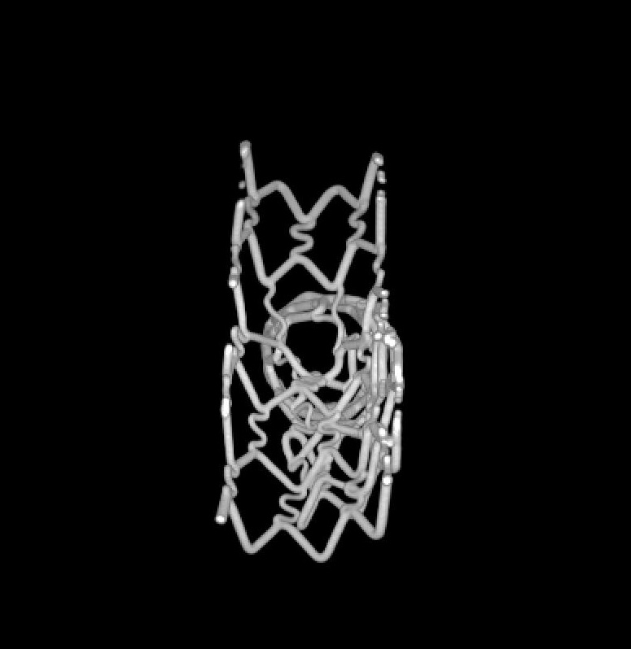
post KBT
Model 2
4×3mm
post KBT
Side branch strut
Jailed side branch
Main branch strut
Notes:
6
Although the tube size is different from the previous model, we inserted two stents using the same crush stnet technique. We also post-dilated using KBT at 18atm after implanting the two stents.
When looking at the cross-sectional view of this model, the 2 stent struts showed a jailing effect in this model. This is why sometimes the results are not good, It doesn’t make an enough expansion because of two complex overlapping stent struts. This image shows very clearly the limitations of this technique.

Slide 7
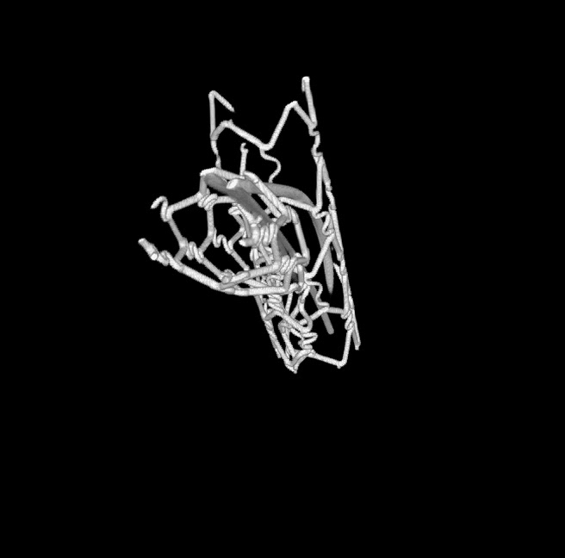
Which wire is the best choice?
Notes:
And it is a miracle that the guide wire gets through the same hole of stent struts even in-vitro model. Under x-ray, no one knows where the guide wire going to.

Slide 8
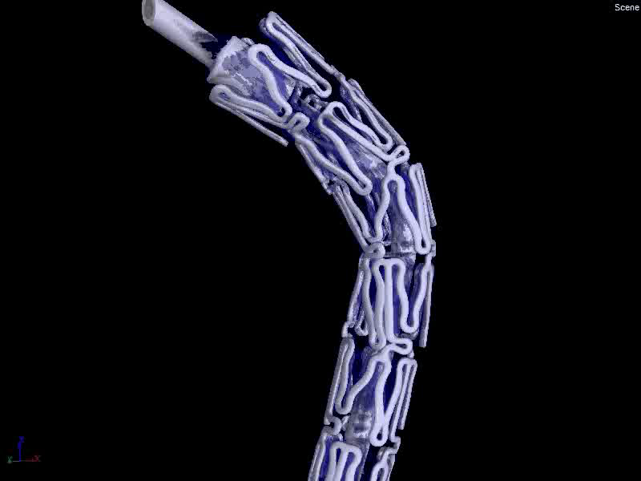
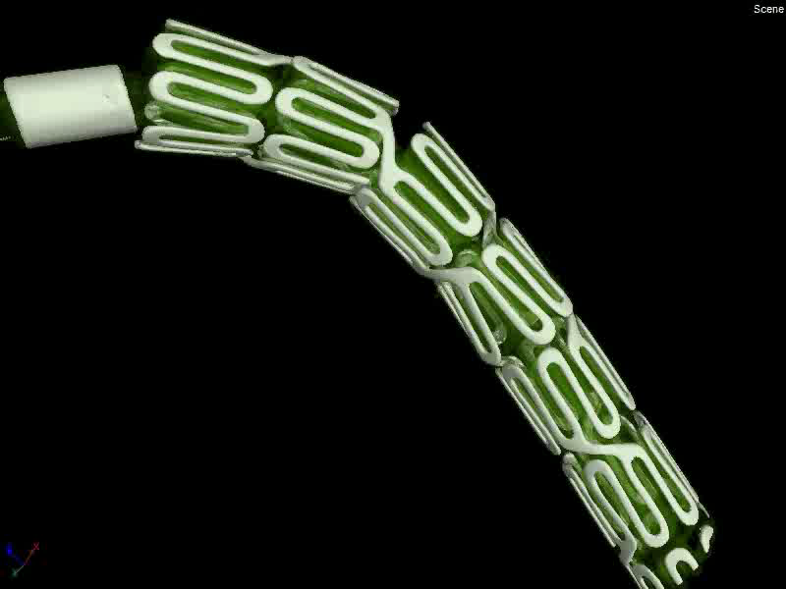
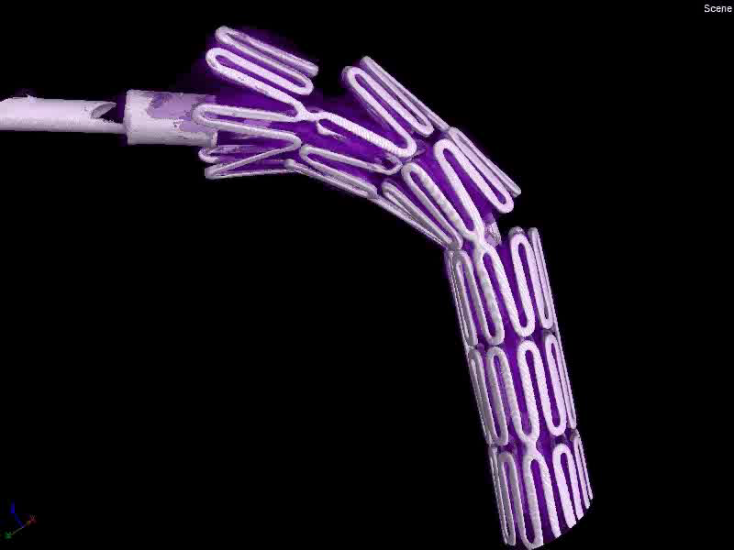
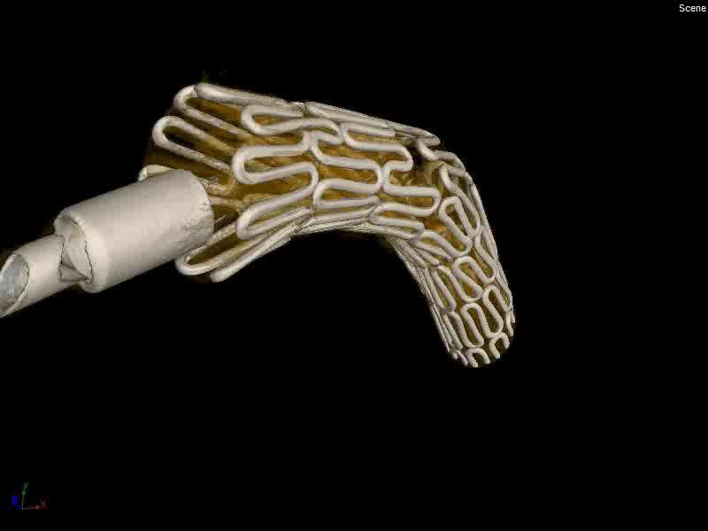
Element
3.0×24mm
Xpedition
3.0×23mm
Nobori
3.5×18mm
Integrity
3.5×18mm
Notes:
This is a crossability test using severe throchas lesion. We can understand clearly the deformation of distal part strut especially stent

Slide 9
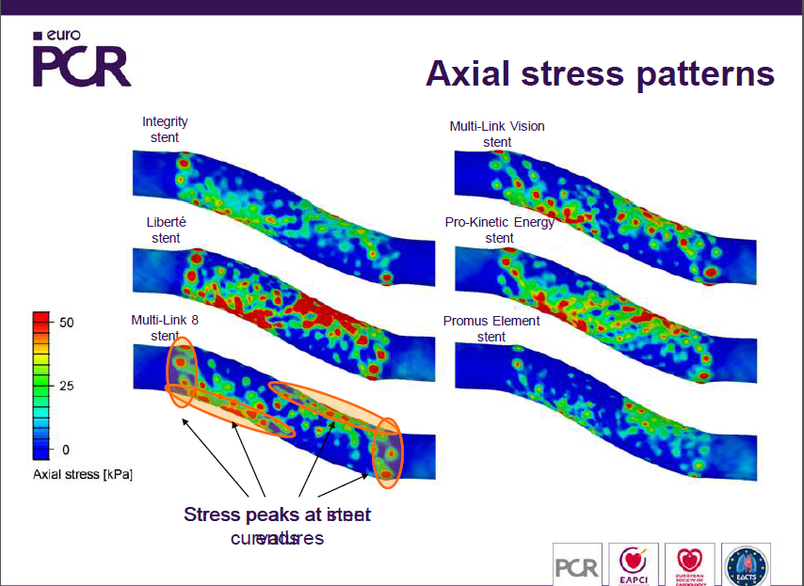
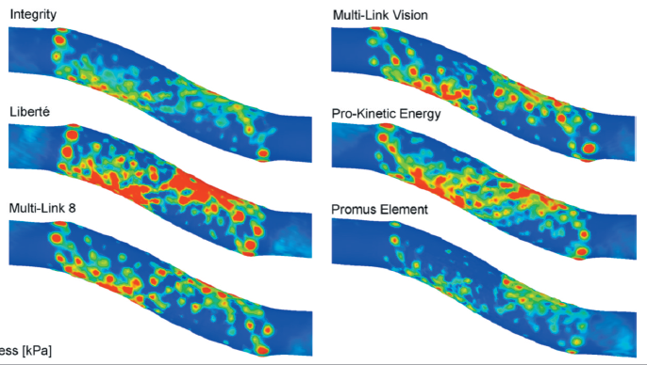
Axial Stress [kPa]
Stress peaks at stent ends
Courtesy of Dr.P. Mortie
Notes:
Using computer simulation tent, we can finds the vessel received axial stress after stenting

Slide 10
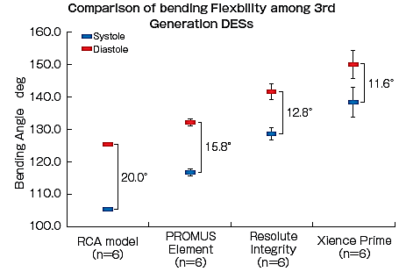
Comparison of Bending Flexibility among different stents for RCA Deforming

Slide 11
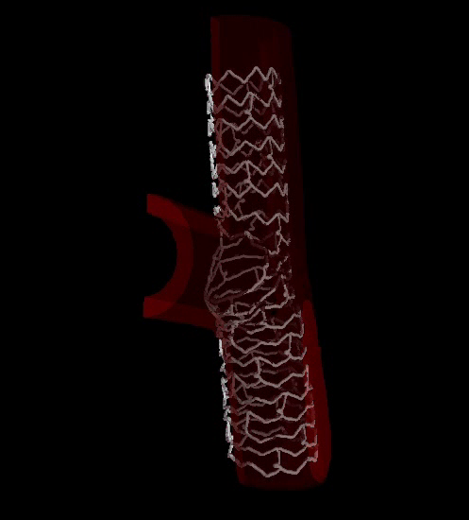
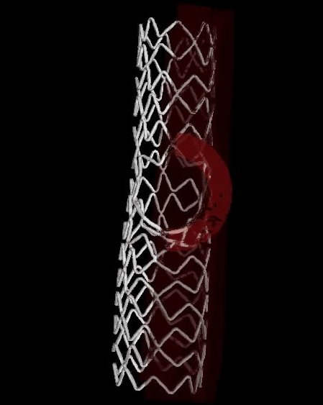
3-link stent 2-link stent
3-link Stent Ф3.5mm
4.0×4.0×80°
Notes:
This is the images of after final kissing balloon dilatation

Slide 12
Distal bifurcation

Slide 13
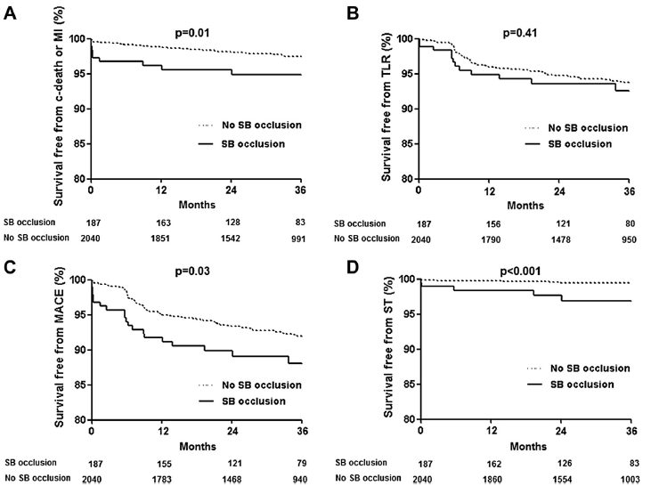
I am not recommending FKBD to all bifurcation cases.
JH Hahn, HC Gwon:J Am Coll Cardiol. 2013;62(18):1654-1659

Slide 14
But, the importance of SB is undeniable, thus, performing additional techniques is necessary to secure SB depending on the vessel dominant region, blood flow rate after treatment and symptom.

Slide 15
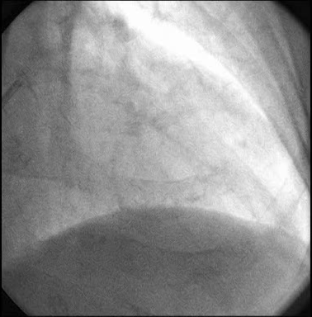
Case: LAD bifurcation

Slide 16
YH Kim TCTAP 2014

Slide 17
YH Kim TCTAP 2014

Slide 18
Routine FKBD ?
Now days, the simultaneous pressure inflation using NC type-proper-size-balloon for main and side vessel as FKBD is recommended and being common practice.
But, is this truly an appropriate choice?
Nobody knows what we believe now is truly a perfect treatment.

Slide 19
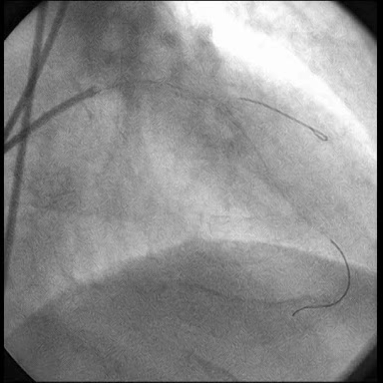
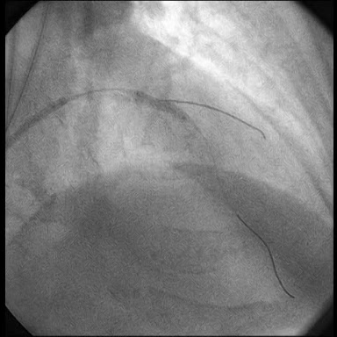
After Integrity implantation
Resolute 3.0mm: 3times inflation
N/C 3.0mm 16atm

Slide 20
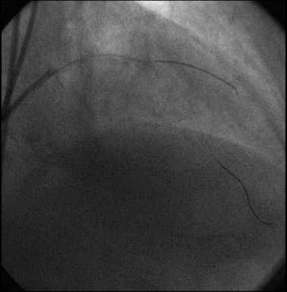
After post dilatation

Slide 21
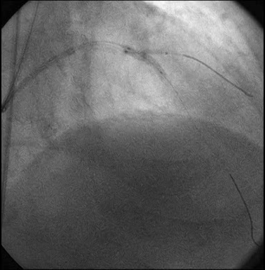
Kissing inflation
MV: 3.0mm 14atm
SB: 2.5mm 3atm

Slide 22
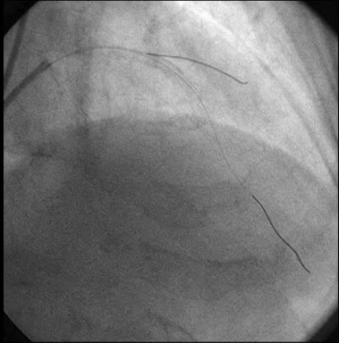
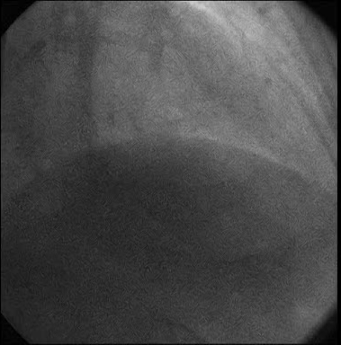
Final CAG

Slide 23
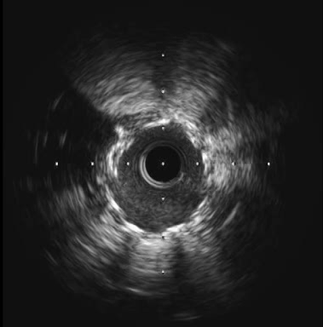
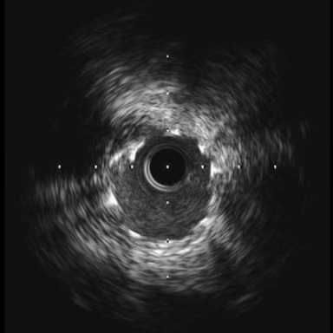
IVUS
Pre FKBD
Post FKBD

Slide 24
Challenging to this common knowledge, I would like to introduce this new ways of FKBD that occurs less complications.
It is Modified-FKBD.

Slide 25
Provisional stenting of coronary bifurcations: insights into final kissing balloon postdilation and stent design by computational modeling
Peter Mortier, PhD^{1,2}, Yutaka Hikichi, MD³, Nicolas Foin, PhD⁴, Gianluca De Santis, PhD^{1,2}, Patrick Segers, PhD², Benedict Verhegghe, PhD^{1,2}, Matthieu De Beule, PhD^{1,}
P Mortie, Y Hikichi, et al: JACC:Cardio Intav, VOL. 7, NO3, 2014

Slide 26
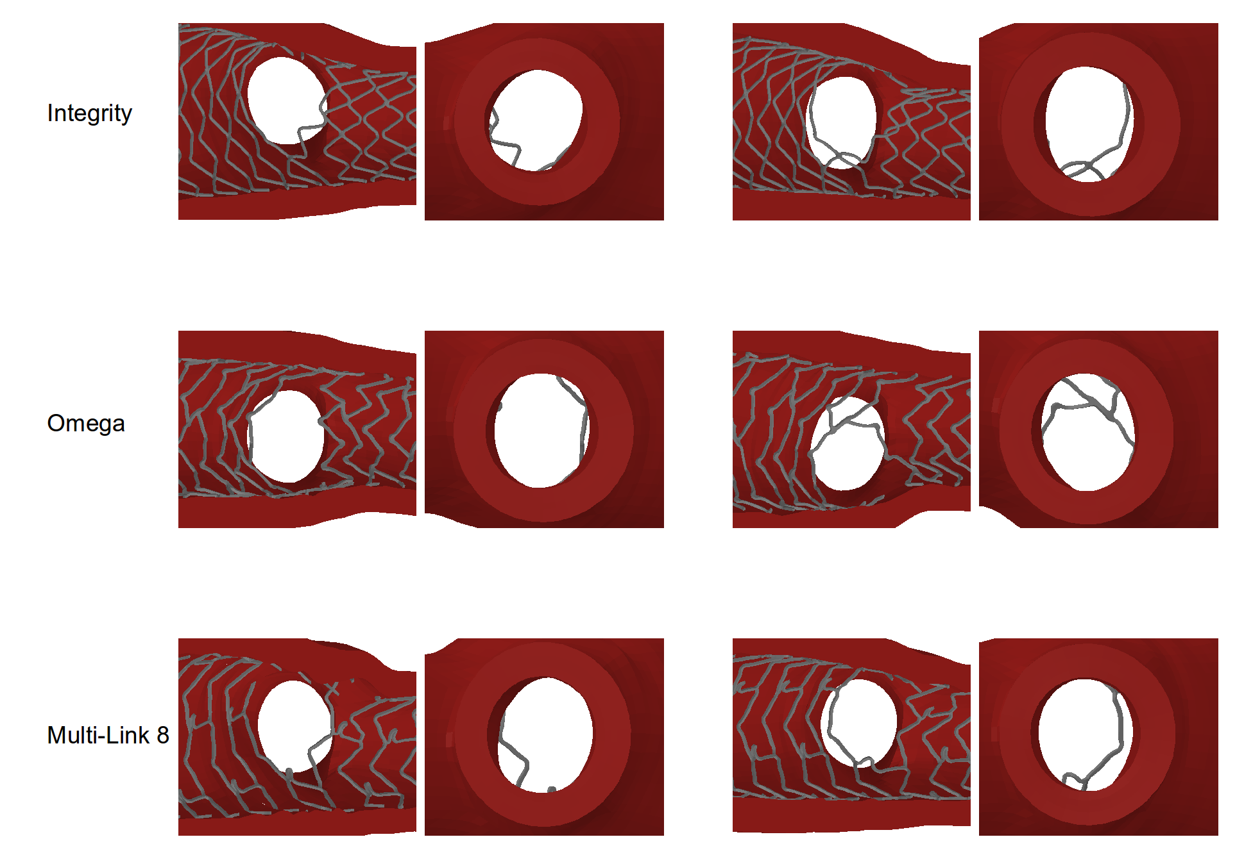
P Mortie, Y Hikichi, et al: JACC:Cardio Intav, VOL. 7, NO3, 2014

Slide 27
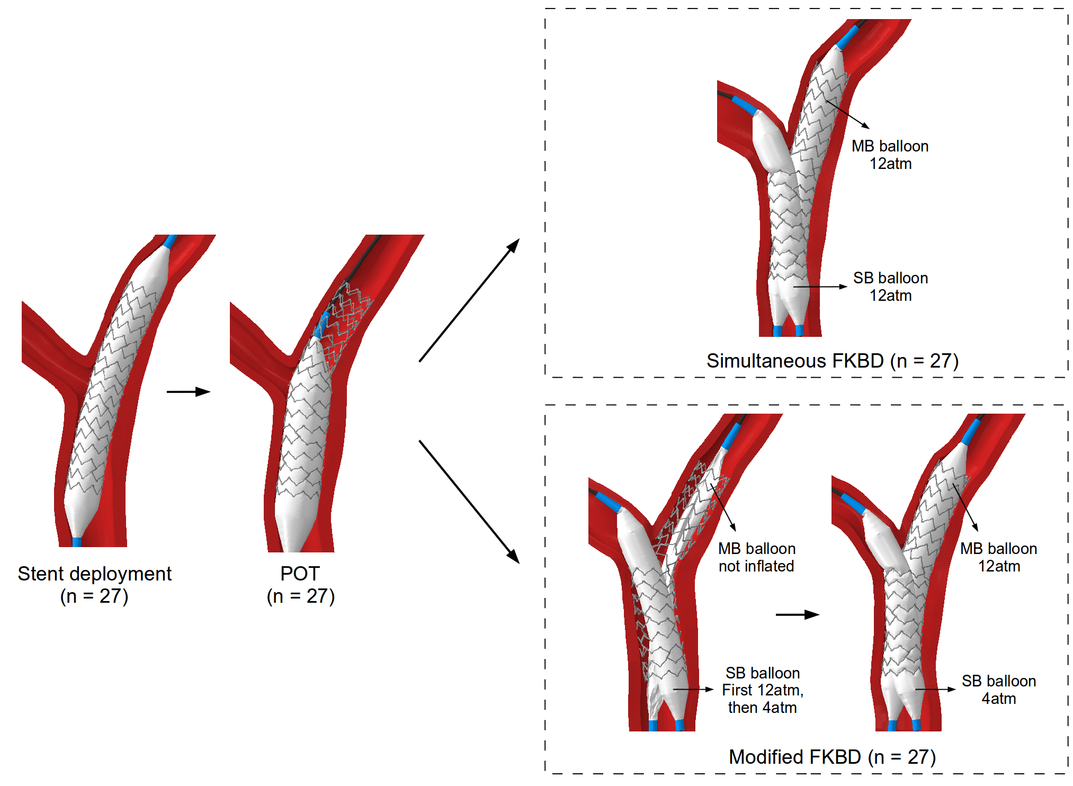
P Mortie, Y Hikichi, et al: JACC:Cardio Intav, VOL. 7, NO3, 2014

Slide 28
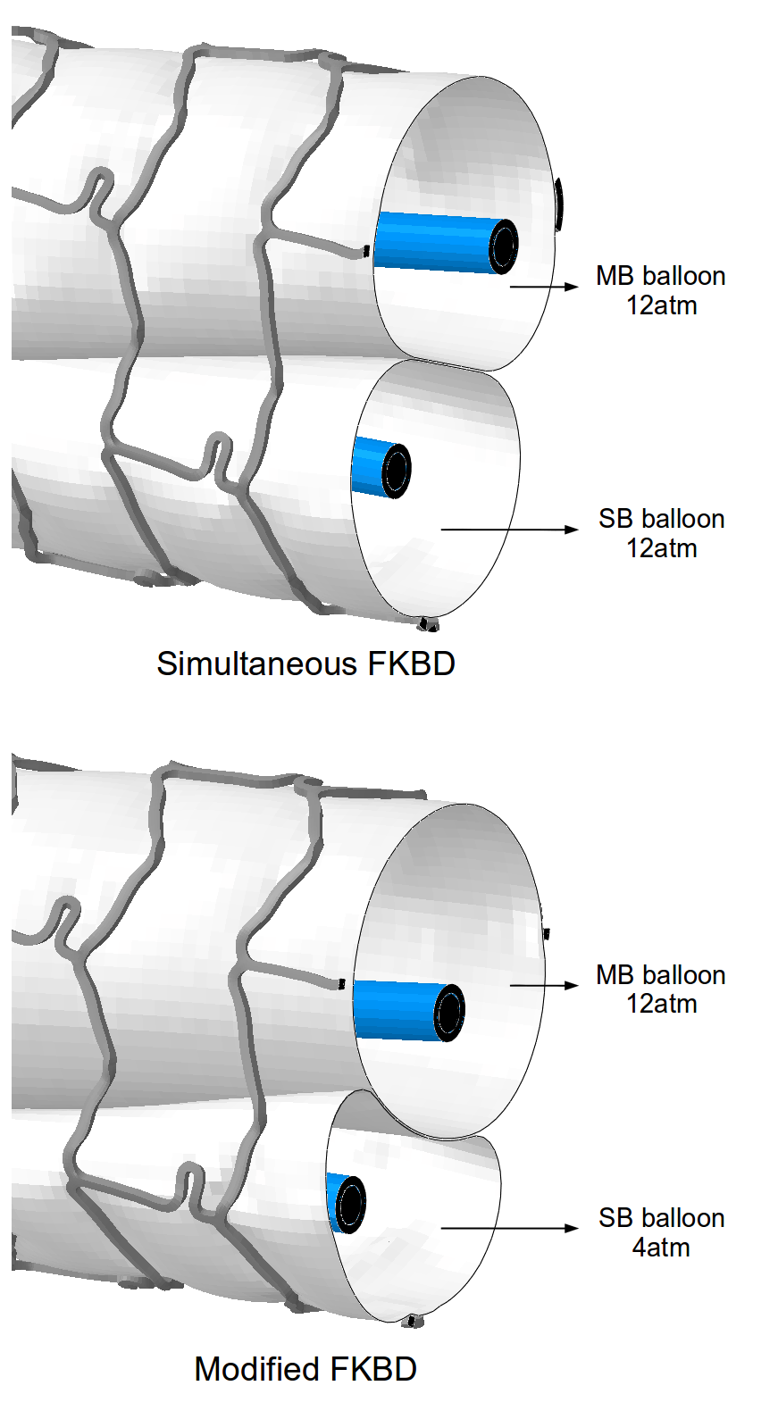
Cross-sectional view of the overlapping balloons during final kissing balloon postdilation
Modified FKBD reduces the elliptical stent deformation of proximal MV.
It will reduce the SB ostium complication.
P Mortie, Y Hikichi, et al: JACC:Cardio Intav, VOL. 7, NO3, 2014

Slide 29
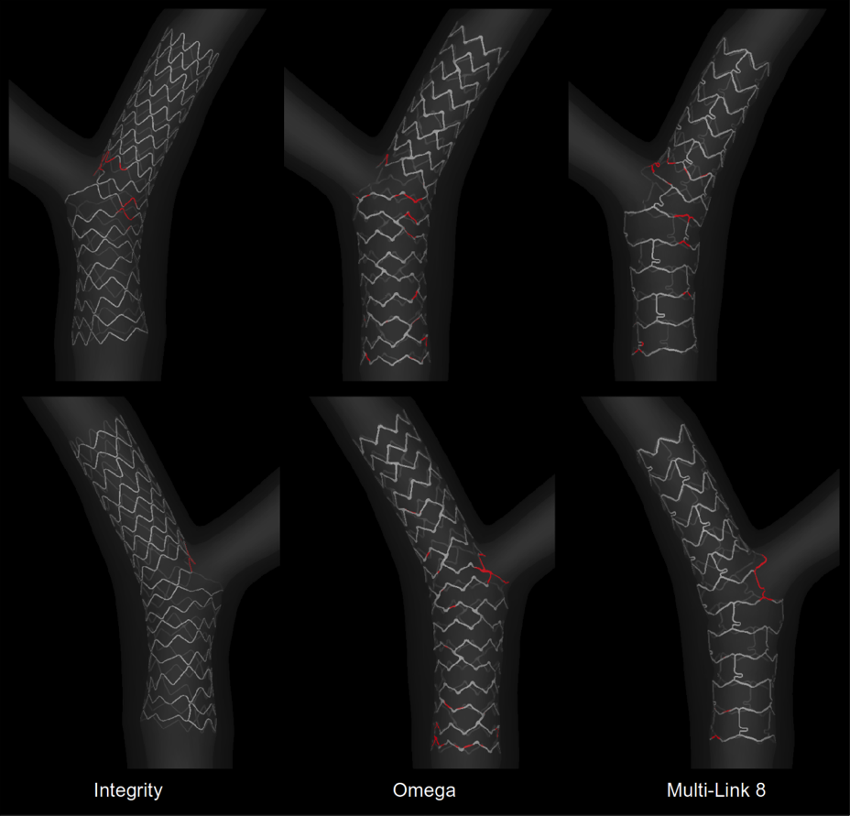
Evaluation of stent strut malapposition
P Mortie, Y Hikichi, et al: JACC Intav. in press

Slide 30
 | Simultaneous FKBD | Modified FKBD | p-value
Ostial stenosis | 20±11% | 15±9% | < 0.001
Ellipticity index | 1.36±0.06 | 1.17±0.05 | < 0.001
Malapposed struts | 6.4±3.4% | 6.3±3.6% | 0.39
Comparison of the results obtained using the simultaneous and the modified final kissing balloon dilatation (FKBD) strategies
Modified FKBD results in a reduced ostial stenosis and decreases the elliptical deformation in the proximal main vessel. The amount of stent strut malapposition was similar in the two techniques.
P Mortie, Y Hikichi, et al: JACC:Cardio Intav, VOL. 7, NO3, 2014

Slide 31
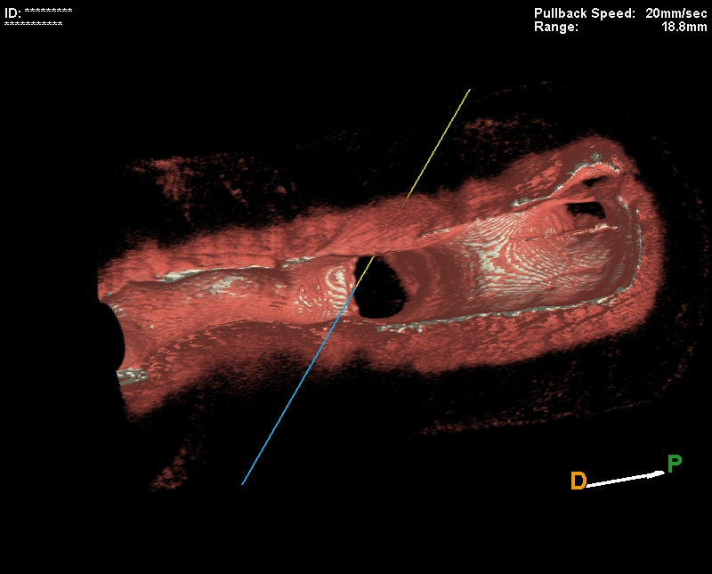
3D-OFDI image
Before stenting

Slide 32
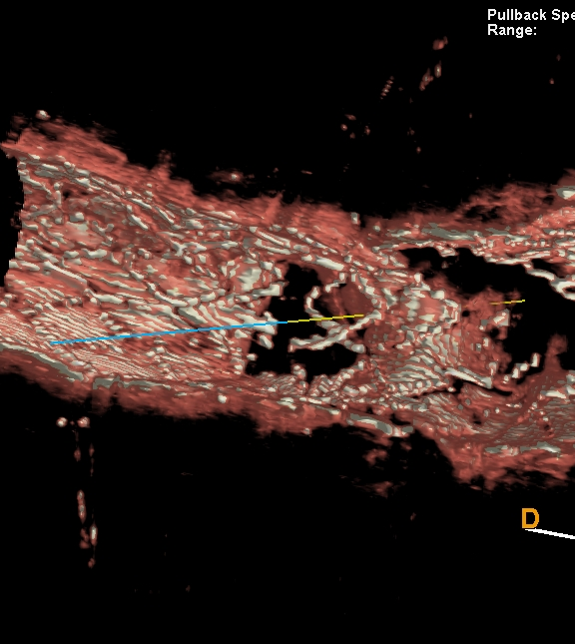
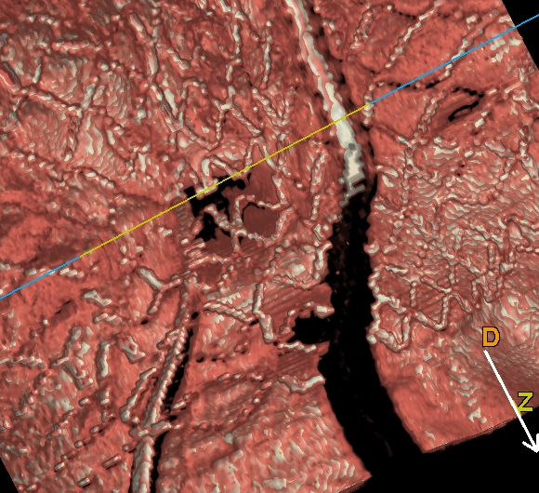
Just after stent implantation

Slide 33
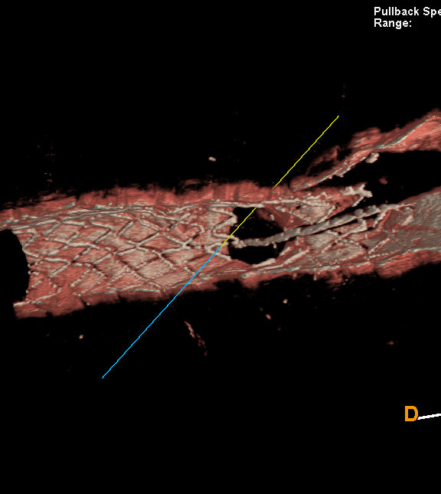
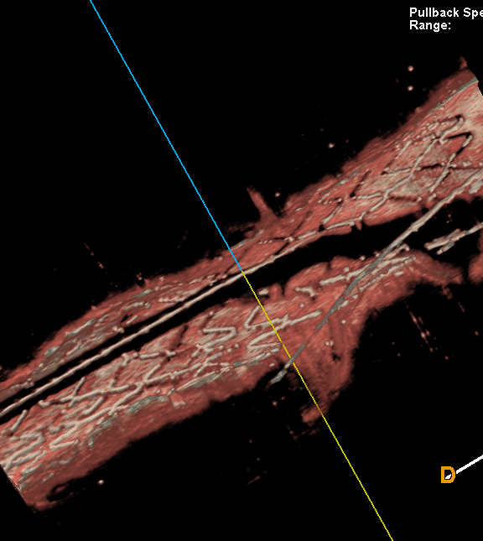
After the modified FKBD

Slide 34
Conclusion
The modified FKBD procedure reduces the elliptical stent deformation, dissection and optimizes the side branch access.
3D images methods of OFDI/OCT will change our bifurcation treatment strategy
Far different results would be obtained, all depending on the “Vessel Diameter" "Bifurcation Angle" "Technique" "stent type", and moreover, the operator's skill.

