Slide 1
Beyond Platelet Reactivity on Clinical Outcomes
Tailored Antiplatelet Therapy
based on
Platelet Reactivity or What Else?
Duk-Woo Park, MD, PhD
Heart Institute, University of Ulsan College of Medicine,
Asan Medical, Seoul, Korea
Notes:
15분강의

Slide 2
Disclosure Statement of Financial Interest
I, (Duk-Woo Park) DO NOT have a financial interest/ arrangement or affiliation with one or more
organizations that could be perceived as a real or
apparent conflict of interest in the context of the
subject of this presentation.

Slide 3
Variable Platelet Reactivity
24 Hours After 300mg Clopidogrel
“Resistance” = 31%
N=96, Elective PCI
20
Patients (%)
10
≤ -30
(-20,-10)
(0,10)
(20,30)
(40,50)
>60
(-30,-20)
(-10,0)
(10,20)
(30,40)
(50,60)
Δ Platelet Aggregation Before and After Clopidogrel (%)
“Resistance” = ≤10% Δ platelet aggregation
Gurbel PA et al., Circulation 2003;107:2908-2913
Notes:
Matetzky S, Shenkman B, Guetta V, et al. Clopidogrel resistance is associated with increased risk of recurrent atherothrombotic events in patients with acute myocardial infarction. Circulation. 2004;109:3171-3175.

Slide 4
ADAPT-DES
Assessment of Dual AntiPlatelet Therapy with Drug-Eluting Stents
11,000 DES pts prospectively enrolled
No clinical or anatomic exclusion criteria
11 sites in US and Germany
PCI with ≥1 non-investigational DES
Successful and uncomplicated
(IVUS/VH substudy; Up to 3000 pts enrolled)
Assess platelet function after adequate DAPT loading and GPI washout: Accumetrics VerifyNow Aspirin, VerifyNow P2Y12, and VerifyNow IIb/IIIa assays (results blinded)
Clinical FU at 30 days, 1 year and 2 years
Angio core lab assessment all STs w/1:2 matching controls
clinicaltrials.gov NCT00638794
Stone GW et al. Lancet 2013

Slide 5
ADAPT-DES: Stent thrombosis (definite or probable) according to post-PCI PRU
2
PRU >208 (n=3610)
HR [95%CI] =
2.54 [1.55, 4.16]
P=0.0001
PRU ≤208 (n=4839)
1.3%
Stent thrombosis
(def/prob) (%)
1
0.5%
0
0
3
6
9
12
Number at risk:
Months
PRU > 208
3610
3450
3420
3380
3152
PRU ≤ 208
4839
4688
4654
4631
4341

Slide 6
ADAPT-DES: MI and major bleeding according to post-PCI PRU
Myocardial infarction
HR [95%CI] = 1.47 [1.15, 1.87]
P=0.002
Major bleeding
HR [95%CI] = 0.83 [0.69, 0.99]
P=0.04
10
10
PRU >208 (n=3610)
PRU >208 (n=3610)
PRU ≤208 (n=4839)
PRU ≤208 (n=4839)
6.7%
5.6%
5
5
3.9%
2.7%
0
0
0
6
12
0
6
12
Months
Months

Slide 7
Hypothetically Increasing Clopidogrel Response in Pts with >208 PRU → Incremental Decrease in Stent Thrombosis (from 1.3%) vs. Increase in Bleeding (from 5.6%)
Efficacy
treatment effect
(from MV HR 2.51)
18
16
ST ↓ 15% (to 1.1%)
ST ↓ 20% (to 1.0%)
ST ↓ 25% (to 1.0%)
ST ↓ 30% (to 0.9%)
ST ↓ 35% (to 0.8%)
ST ↓ 40% (to 0.8%)
ST ↓ 45% (to 0.7%)
ST ↓ 50% (to 0.7%)
ST ↓ 55% (to 0.6%)
ST ↓ 60% (to 0.6%)
ST ↓ 65% (to 0.5%)
ST ↓ 70% (to 0.4%)
14
12
10
NNT/NNH
(# of ↑ Bleeding to Prevent One ST)
8
6
4
2
If max effect on ST and bleeding:
~4 bleeds caused for each ST prevented
0
↑ 10%
(to 6.1%)
↑ 20%
(to 6.6%)
↑ 30%
(to 7.2%)
↑ 40%
(to 7.7%)
↑ 50%
(to 8.2%)
↑ 60%
(to 8.8%)
Safety treatment effect: Major bleeding increase (from MV HR 0.76)

Slide 8
Not Surprisingly, a Very Strong Drug Effect is Also
Associated with Bleeding
Campo et al. J Am Coll Cardiol 2011;57:2474-2483.

Slide 9

Booming of Post-of-Care Platelet function Test

Slide 10
Use of Platelet Function Testing
Is there evidence of a P2Y₁₂ antagonist effect?
Outcome has happened
DIAGNOSTIC TEST
What is the risk of a CV event?
Role as tailored therapy?
PROGNOSTIC TEST
Assessment of diagnostic and prognostic utility differ!!

Slide 11
Price MJ et al , JAMA 2011
GRAVITAS Trial
Elective or Urgent PCI with DES*
VerifyNow P2Y12 Test 12-24 hours post-PCI
N=5429
Yes
PRU ≥ 230
No
Normal On-treatment Reactivity
High On-treatment Reactivity
Random Selection
R
N = 1109
N = 1105
N = 586
High-Dose Clopidogrel†
clopidogrel 600-mg, then
clopidogrel 150-mg/day
Standard-Dose Clopidogrel†
clopidogrel 75-mg/day
Standard-Dose Clopidogrel†
clopidogrel 75-mg/day
Primary Efficacy Endpoint: CV Death, Non-Fatal MI, Stent Thrombosis at 6 mo
Key Safety Endpoint: GUSTO Moderate or Severe Bleeding at 6 mo
Pharmacodynamics: Repeat VerifyNow P2Y12 at 1 and 6 months
*Peri-PCI clopidogrel per protocol-mandated criteria to ensure steady-state at 12-24 hrs
†placebo-controlled
All patients received aspirin (81-162mg daily)
Notes:
11

Slide 12
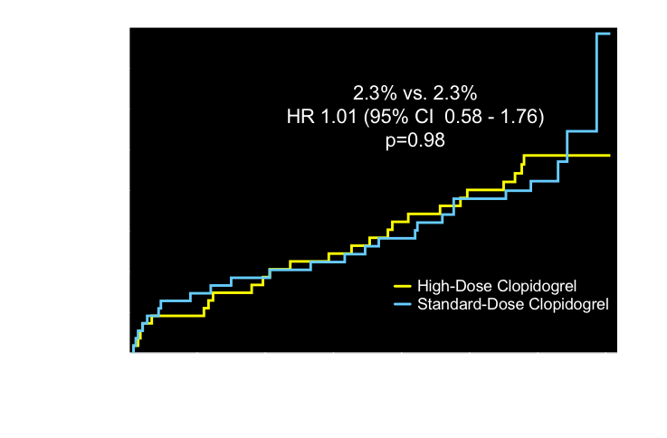
Primary Endpoint: CV Death, MI, Stent Thrombosis
Observed event rates are listed; P value by log rank test.
Price MJ et al, JAMA. 2011;305(11):1097-1105
Notes:
12
In GRAVITAS, there were no differences in the primary endpoint between the randomized groups.

Slide 13
TRIGGER-PCI
Successful PCI with DES without major complication and NO GPIIb/IIIa use
N ~6,800
Post-PCI VerifyNow P2Y12 Assay (PRU)
2 - 4 hours after 1st MD of clopidogrel 75 mg at day 1 post-PCI
Yes
PRU >208
No
Responder
Non-Responder
N = 2,150
R
N = 1075
N = 1075
N = 4650
“Prasugrel arm”
Prasugrel 60 mg LD
Prasugrel 10 mg MD
+ Clopidogrel placebo
“Clopidogrel arm”
Placebo LD
Clopidogrel 75 mg MD
+ Prasugrel placebo
“Standard Therapy”
Clopidogrel 75 mg
Non-interventional study (Registry)
Clinical follow-up and blinded VerifyNow assessment at 90 days and 180 days
Primary endpoint: 6 month CV Death or MI
Trenk D et al. JACC 2012;59:2159–64

Slide 14
TRIGGER-PCI:
Primary and Secondary Endpoints
 | Prasugrel N=212 | Clopidogrel N=211
Primary endpoint: CV death or MI | 0 | 1 (0.5%)
- CV death | 0 | 0
- MI | 0 | 1 (0.5%)
Secondary endpoints
- Rehospitalization for ischemia | 2 (0.9%) | 4 (1.9%)
- Urgent TVR | 2 (0.9%) | 1 (0.5%)
- Stent thrombosis (def/prob) | 0 | 0
- Stroke | 0 | 1 (0.5%)
Key safety endpoint: TIMI major bleeding (non-CABG) | 3 (1.4%) | 1 (0.5%)
Trenk D et al. JACC 2012;59:2159–64
Notes:
TRIGGER-PCI TCT2011LBCT V3_4 FinalTACW_Trial Protocol and Organization_Franz-Josef Neumann_V1.0_2010-08-27
14
14
LBCT V3_4 FinalTACW_Trial Protocol and Organization_Franz-Josef Neumann_V1.0_2010-08-27
14
14
14
14

Slide 15
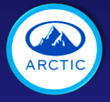
ARCTIC: Design (N=2,440)
Coronary angiogram
Planned PCI with DES
Exclude STEMI and planned GPI use
Rd
Primary endpoint at 12 months:
Death, MI, stroke, stent thrombosis, urgent revascularization
VerifyNow
P2Y12 + ASA
Standard of care
ASA, clopidogrel, prasugrel, GP drug & dose adjustments if high platelet reactivity
Statistical considerations:
Assuming an annual risk of 9% and a 33% relative risk reduction (α risk at 5% and error β of 20%, bilateral test), 2,466 patients were necessary to demonstrate the superiority of the strategy of monitoring and adjustment
DES-PCI
DES-PCI
Drug and dose adjustments if high platelet reactivity at day 14
Standard of care
12-month FU
Montalescot G et al. NEJM 2012

Slide 16
ARCTIC: Primary endpoint to 1 year
(death, MI, stent thrombosis, stroke, or urgent revascularization)
Montalescot G et al. NEJM 2012

Slide 17
Criticism after GRAVITAS, TRIGGER-PCI and ARCTIC
→ ANTARCTIC
Low risk, stable patients
Elective PCI
Predominant use of clopidogrel
Old PRU thresholds (235)
Elderly, ACS patients
Urgent PCI
Predominant use of prasugrel
→ New PRU thresholds (85 and 208)
Montalescot G et al. N Engl J Med 2013;368:871-2
Montalescot G et al. Circulation 2014;129:2136-43

Slide 19
ANTARCTIC design
R
Group 1
Group 2
Conventional Arm :Prasugrel 5 mg
Monitoring Arm :Prasugrel 5 mg
No monitoring
1st assessment : Verifynow P2Y₁₂ : 2 weeks ± 2 d
PRU≥208
85<PRU<208
PRU ≤85
Prasugrel 10 mg/day
Prasugrel 5 mg
Clopidogrel 75 mg/day
2nd assessment and adjustment:
Verifynow P2Y₁₂ : 2 weeks ± 2 d
Primary end point (net clinical benefit) over 12 months:: Bleeding type 2,3,5 of the BARC definition and MACE (CV death, MI, urgent revascularisation, stent thrombosis, stroke)

Slide 20
Primary Endpoint
CV death, MI, stroke, stent thrombosis, urgent revascularization or BARC 2, 3 or 5

Slide 21
Bleeding events

Slide 22
Mediation Analysis From ADAPT-DES
Mediation analysis (to assess the contribution of platelet reactivity to the MACE risk associated with known CV risk factors
Multivariable Cox proportional hazards regression
Multivariable linear regression
Notes:
22
This is the Bulleted List slide.
To create this particular slide, click the NEW SLIDE button on your toolbar and choose the BULLETED LIST format. (Top row, second from left)
The Sub-Heading and footnote will not appear when you insert a new slide. If you need either one, copy and paste it from the sample slide.
If you choose not to use a Sub-Heading, let us know when you hand in your presentation for clean-up and we’ll adjust where the bullets begin on your master page.
Also, be sure to insert the presentation title onto the BULLETED LIST MASTER as follows:
Choose View / Master / Slide Master from your menu.
Select the text at the bottom of the slide and type in a short version of your presentation title.
Click the SLIDE VIEW button in the lower left hand part of your screen to return to the slide show. (Small white rectangle)

Slide 23
p=0.10

Slide 24
Mediation Analysis From ADAPT-DES
After successful PCI with DES, residual PR mediated only a small proportion of the thrombotic risk associated with clinical risk factors.
Intensified P2Y12 receptor inhibition for high-risk individuals may therefore not substantially mitigate their excess risk.
Notes:
24
This is the Bulleted List slide.
To create this particular slide, click the NEW SLIDE button on your toolbar and choose the BULLETED LIST format. (Top row, second from left)
The Sub-Heading and footnote will not appear when you insert a new slide. If you need either one, copy and paste it from the sample slide.
If you choose not to use a Sub-Heading, let us know when you hand in your presentation for clean-up and we’ll adjust where the bullets begin on your master page.
Also, be sure to insert the presentation title onto the BULLETED LIST MASTER as follows:
Choose View / Master / Slide Master from your menu.
Select the text at the bottom of the slide and type in a short version of your presentation title.
Click the SLIDE VIEW button in the lower left hand part of your screen to return to the slide show. (Small white rectangle)

Slide 25
From GRAVITAS to
ARCTIC and ANTARCTIC:
What about the concept of Tailored Antiplatelet Therapy?
Finished or Failed ?
What Else?
Beyond Platelet Reactivity
Notes:
15분강의

Slide 26
What Else? Beyond Platelet Reactivity
Park DW et al. J Am Coll Cardiol 2011;58:2630–9

Slide 27
Park DW et al. J Am Coll Cardiol 2011;58:2630–9

Slide 28
Park DW et al. J Am Coll Cardiol 2011;58:2630–9

Slide 29
Ticagrelor vs. Clopidogrel in Patients Undergoing PCI with Elevated C-Reactive Protein
Patients undergoing elective PCI with DES implantation and
with elevated high sensitivity C-reactive protein >2mg/L (Total, N=2250 patients)
R
N = 1125
N = 1125
Ticagrelor
Loading dose: 180 mg
Maintenance dose: 90 mg twice daily
Clopidogrel
Loading dose: 300 mg
Maintenance: 75 mg once daily
hsCRP and VerifyNow P2Y12 measurements at discharge, 1 and 12 months
and Clinical Follow-up at 1, 6, and 12 months
Primary Endpoint: All-cause death, MI, stroke, and stent thrombosis at 12 months
Notes:
29
29

Slide 30
Ongoing RCT on
Tailored Antiplatelet in ACS

Slide 31
Tailored Antiplatelet Therapy
Based on Platelet Reactiviy
Many RCTs confirms failure to improve the prognosis of patients by monitoring platelet function to individualize antiplatelet therapy. Failure is not related to the risk level of the population or type of P2Y12 antagonist.
In the contemporary clinical practice, the concept of tailored antiplatelet therapy is (almost) finished.
Still, a few studies on the same topic are still ongoing.

Slide 32
Tailored Antiplatelet Therapy Based on
What Else Beyond Platelet Reactiviy??
Several biomarkers or genetic markers suggested prognostic utility and potential marker for tailored antiplatelet therapy.
However, there have been no evidence to support such “proof-of-concept” tailored antiplatelet therapy using other markers beyond platelet reactivity.
In the current practice, clinical judgment might be at best factors for decision-maker for optimal antiplatelet therapy.

Slide 33
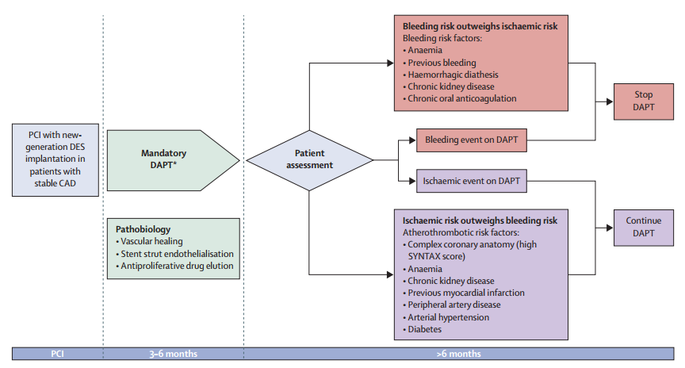
Clinical Judgement on Antiplatelet Therapy in the Contemporary Practice
How to discriminate between ischemic and bleeding risk?
Piccolo, Giustino, Mehran, Windecker – Lancet 2015

