Slide 1
Antiplatelet Treatment beyond Hemostasis
Young-Hoon Jeong, M.D., Ph.D., FAHA
Director, Cardiovascular Center, Gyeongsang National University Changwon Hospital, Korea.

Slide 2
Disclosure
Research Grants/Support Astrazeneca Otsuka
Haemonetics ITC Han-Mi Pharmaceutical KSIC GNUH
Honoraria/Consulting
Astrazeneca
Daiichi Sankyo Inc
Sanofi-Aventis
Otsuka
Haemonetics
Han-Mi Pharmaceutical

Slide 3
Like Life, Antiplatelet Tx is a Balancing Act
Antiplatelet Tx
↓ST/MI
↑Bleeding
Notes:
3

Slide 4


Slide 5
Platelet Function Beyond Hemostasis
Diverse roles
- Promoting inflammatory and immune response
- Maintaining vascular integrity
- Contributing wound healing
Underlying mechanisms
- Recruit leukocytes and progenitor cells to the sites of vascular injury or thrombosis
- Store, produce and release pro-inflammatory, anti-inflammatory and angiogenic factors and microparticles into the circulation
- Spur thrombin generation
Disease entities related with platelets endothelial dysfunction, atherosclerosis, restenosis, LV remodeling, cancer, IBD, RA, SLE, psoriasis, sepsis, acute lung injury, transplantation rejection…
Notes:
5

Slide 6
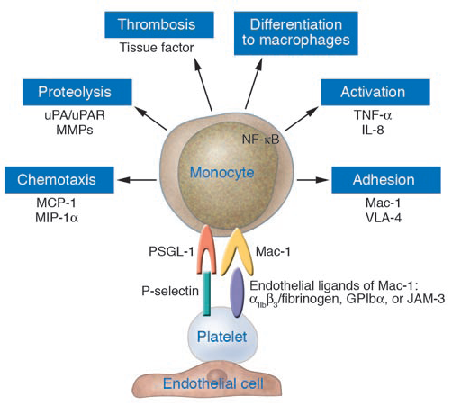
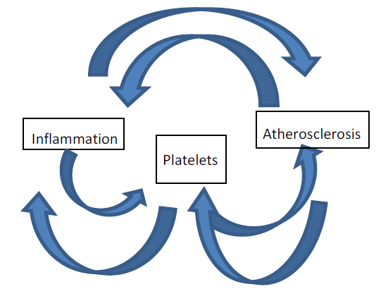
Central Role of Platelets in Atherosclerosis
J Clin Invest J. 2005;115:3378-84.
Notes:
6

Slide 7
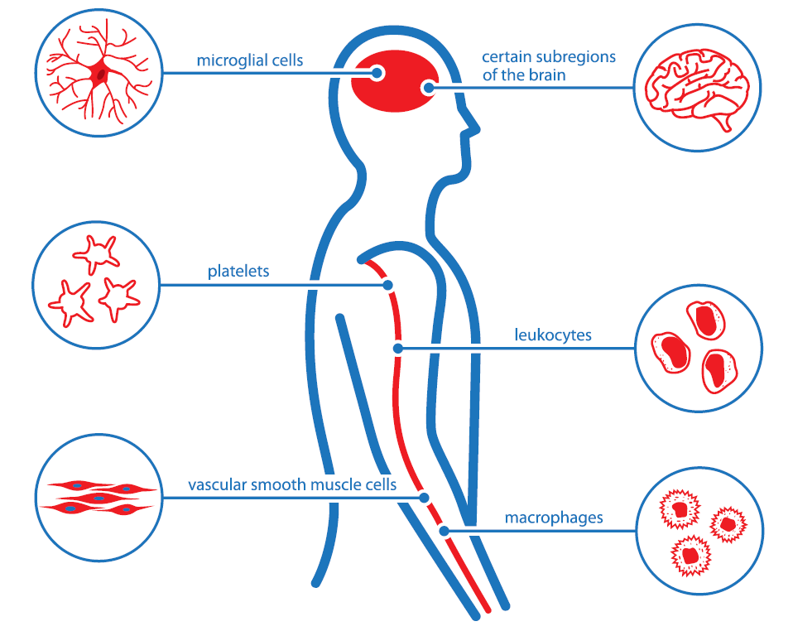
Distribution of P2Y₁₂ Receptor
Adamski P, et al. Thromb Haemost 2014;112.
Notes:
7

Slide 8
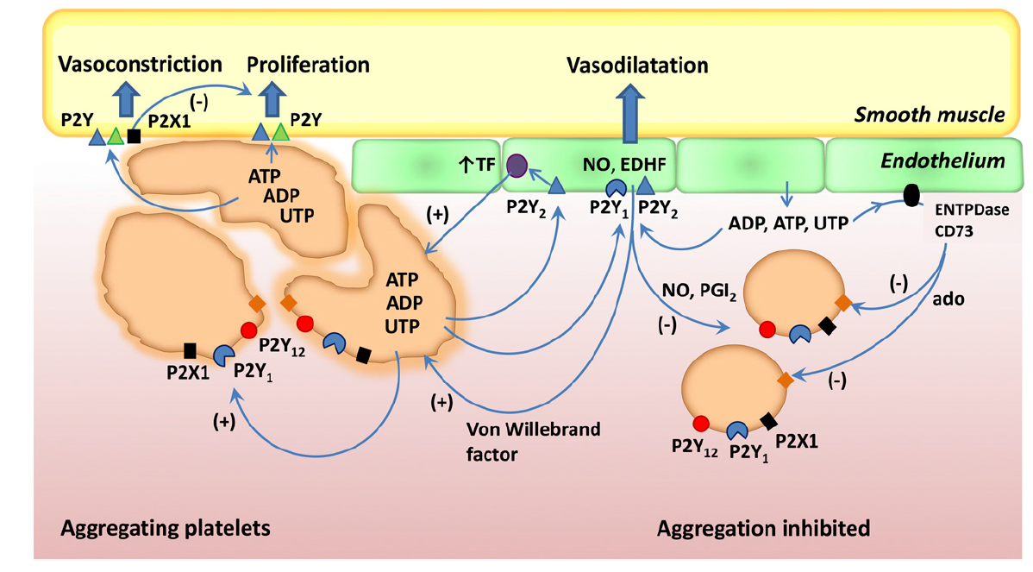
“P2Y”: Control of Vessel Tone & Thrombosis
Burnstock G, et al. Pharmacol Rev 2013;66:102-92.
Notes:
8

Slide 9
Role of Platelet in CV Disease Entities
Endothelial Function
Atherosclerosis & Restenosis
Wound Healing & Remodeling
Adenosine-related Effect
Notes:
9

Slide 10
Role of Platelet in CV Disease Entities
Endothelial Function
Atherosclerosis & Restenosis
Wound Healing & Remodeling
Adenosine-related Effect
Notes:
10

Slide 11
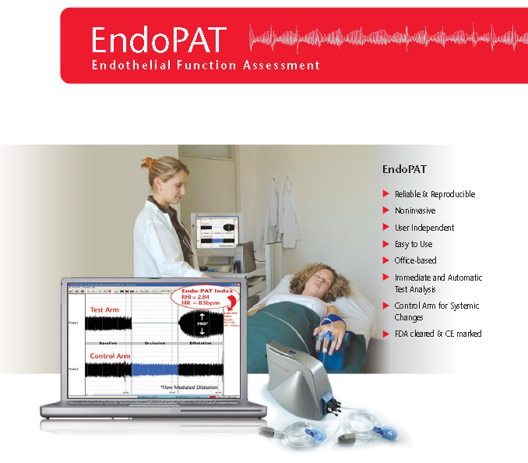
Impact of Clopidogrel on Endothelial Function
  CAD Pts (n = 40): Aspirin only vs. DAPT
RHI (Reactive Hyperemia Index): Peripheral Endothelial Dysfunction
P= 0.004
Willoughby SR, et al. Heart Lung Circ 2014;23:534-41.
Notes:
11

Slide 12
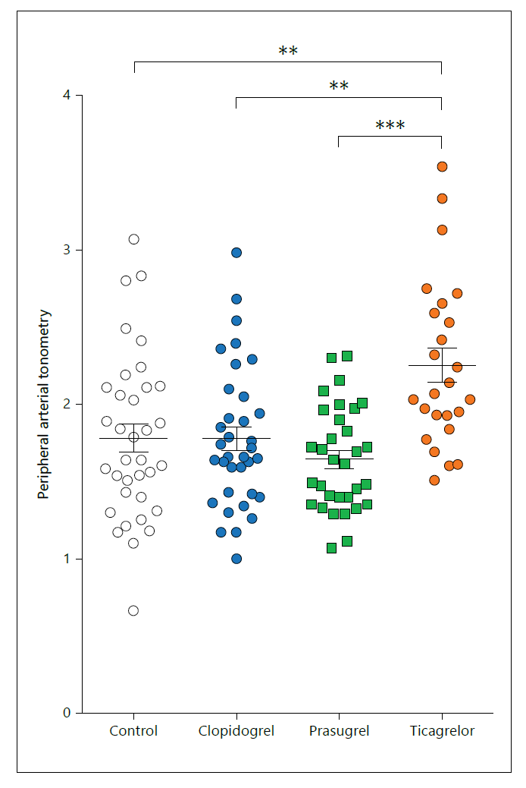
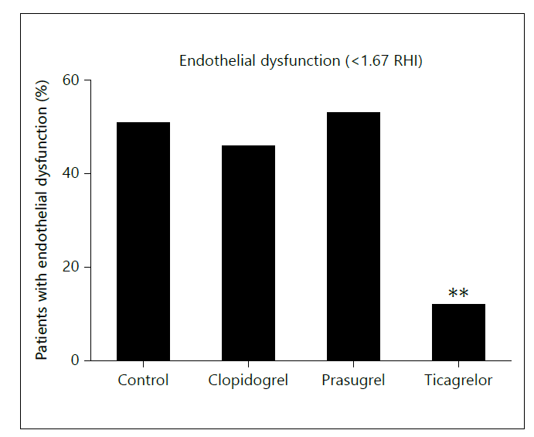
Impact of APT on Peripheral ED in ACS Patients
  ACS Pts on Chronic Aspirin 75 mg/d: Control vs. CLPD 75 mg/d vs. PRAS 10 mg/d vs. TICA 90 mg bid (3-12 Mos.)
Reactive Hyperemia Index
Torngren K, et al. Cardiology 2013;124:252-8.
Notes:
12

Slide 13
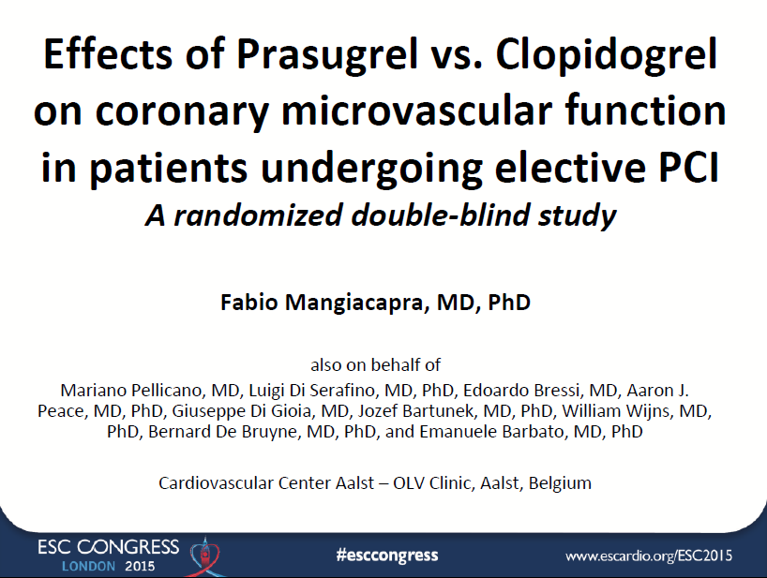
J Am Coll Cardiol 2016.
Notes:
13

Slide 14
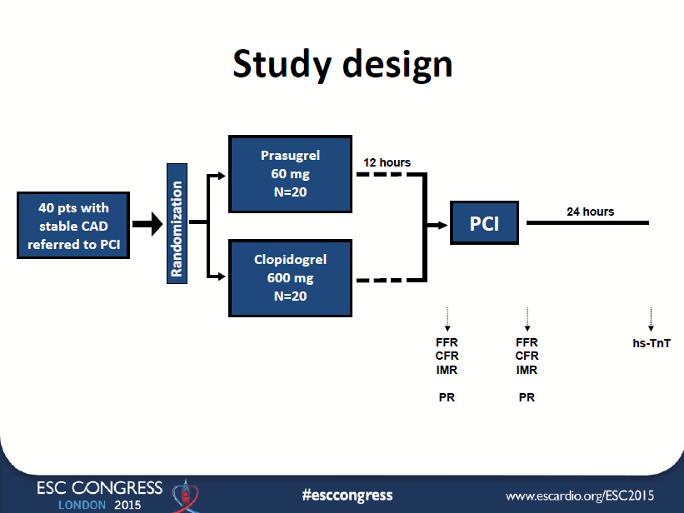
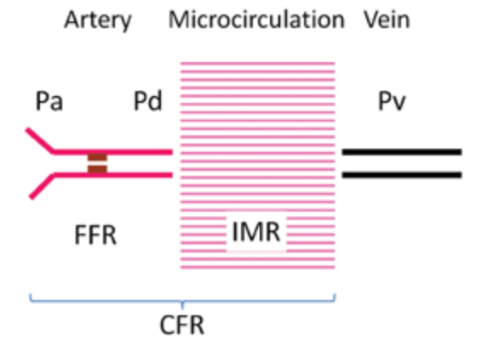

Slide 15
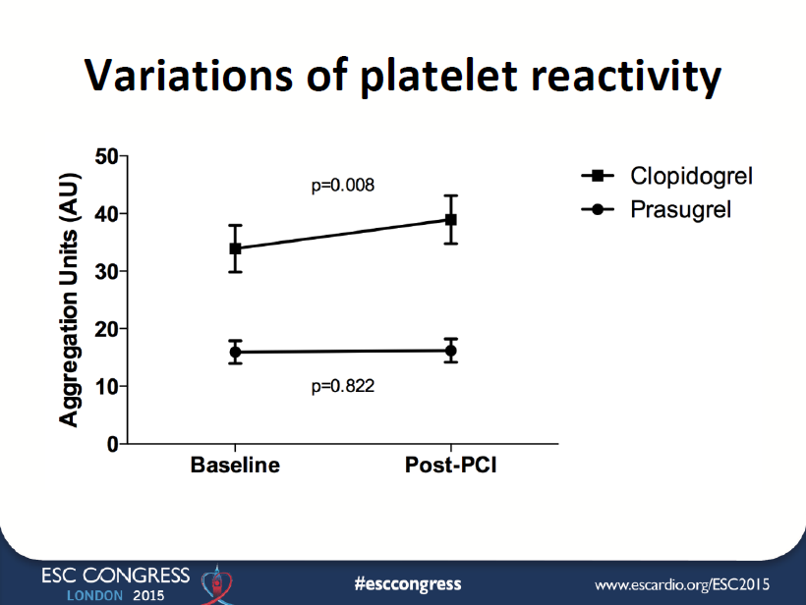

Slide 16
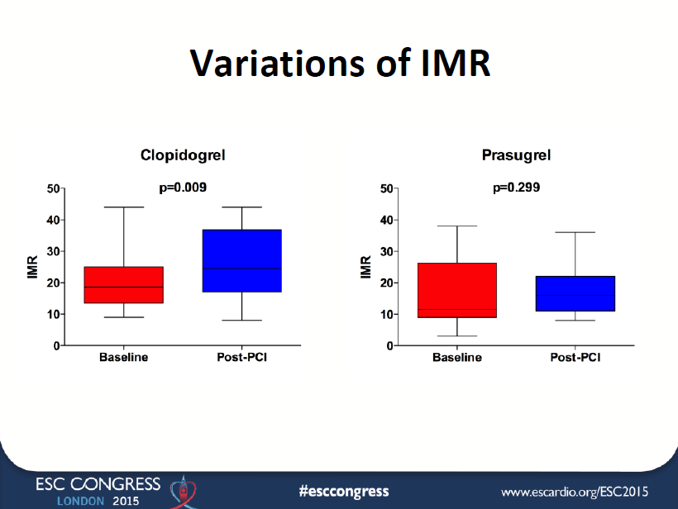

Slide 17
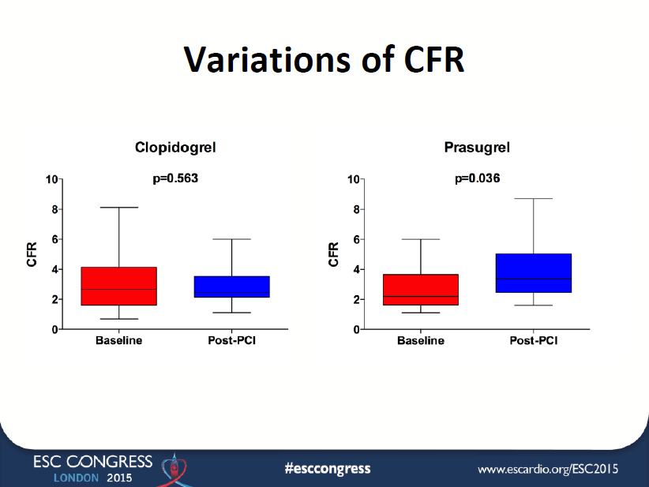

Slide 18
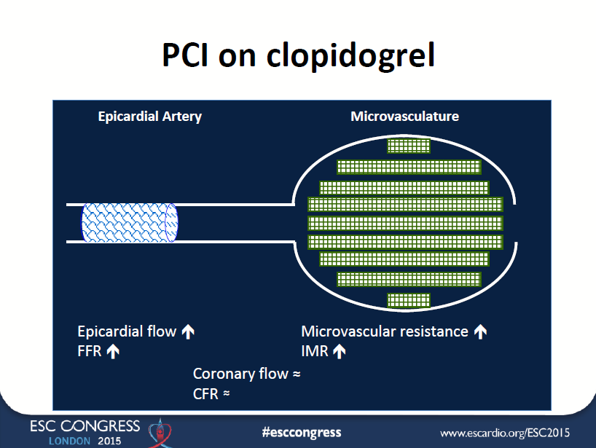

Slide 19
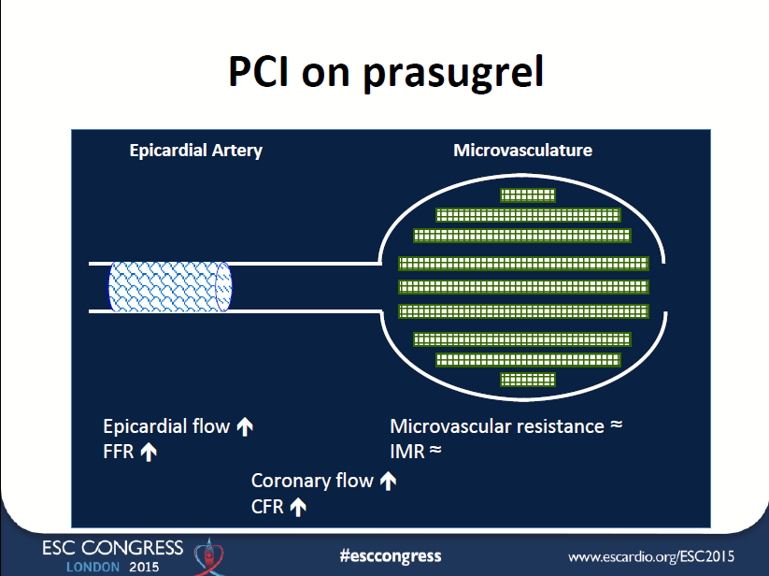

Slide 20
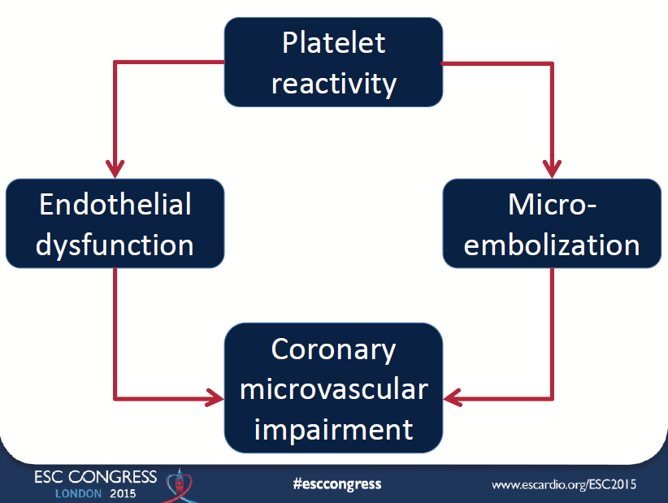

Slide 21
Role of Platelet in CV Disease Entities
Endothelial Function
Atherosclerosis & Restenosis
Wound Healing & Remodeling
Adenosine-related Effect
Notes:
21

Slide 22
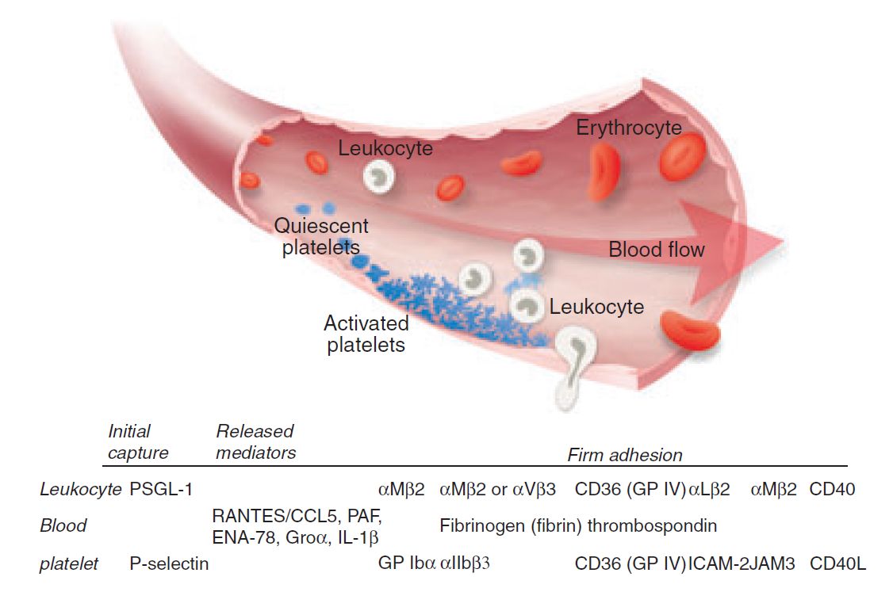
Endothelium-Platelet-Leukocyte Interaction
(Mac-1)
Smyth SS et al. J Thromb Haemost 2009;7:1759-66.
Notes:
22

Slide 23
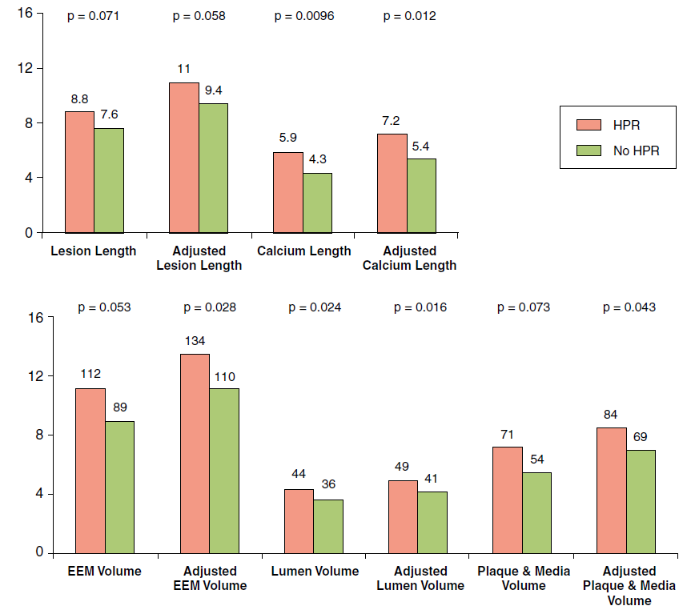
Relationship Between Atheroma Burden and HPR
  IVUS imaging in PCI-treated Patients (n = 335): PRU > 230 (32.5%)
* Adjustments for age, sex, DM, and CRF
Chirumamilla AP, et al. JACC CV Imaging 2012;5:540-9.
Notes:
23

Slide 24
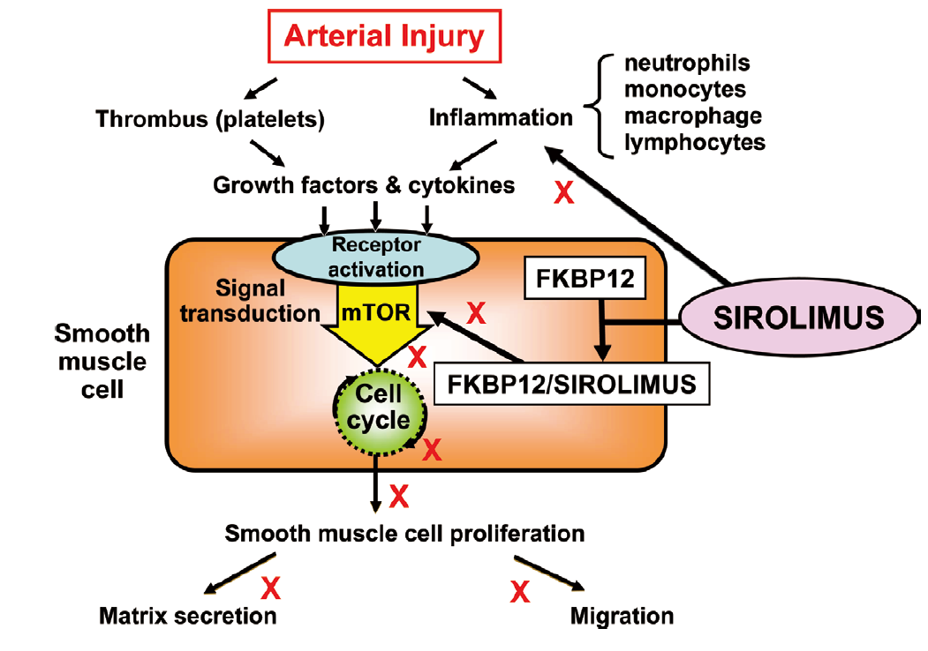
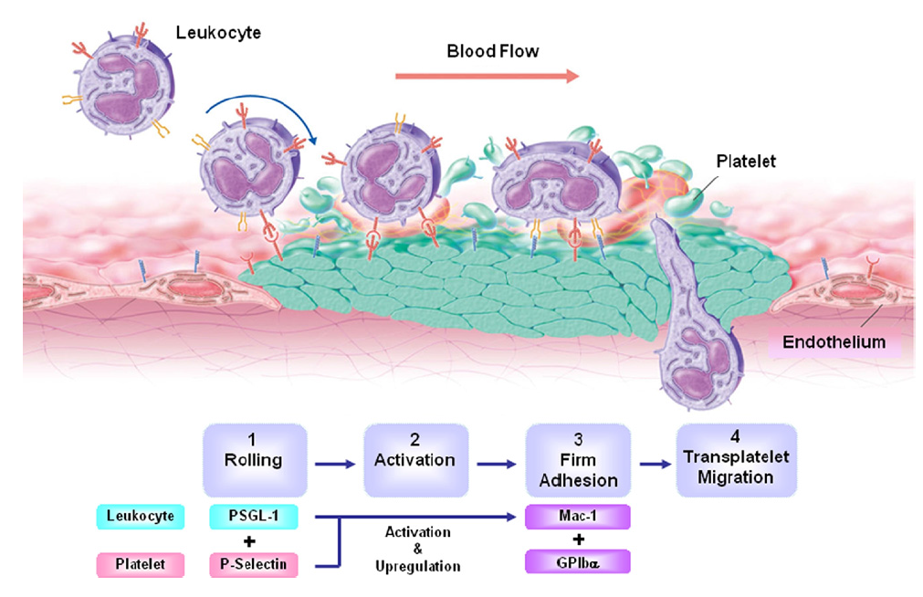
Mechanism of Neointimal Hyperplasia After Stenting
Inoue T, et al. JACC CV Interv 2011;4:1057-66.
Inoue T et al. JACC CV Interv 2011;4:1057-66.
Notes:
At the site of stent implantation after percutaneous coronary intervention, endothelial cells are denuded, and the subendothelial matrix is exposed to flowing
blood. Platelets and fibrinogen immediately adhere to the surface of the injured vessel. A multistep cascade of platelet and leukocyte adhesion molecules direct
leukocyte adhesion to the adherent platelets in a process termed “secondary capture.” Leukocyte capture and rolling are mediated by interaction between platelet
P-selectin and leukocyte P-selectin glycoprotein ligand (PSGL)-1. Arrest and firm adhesion are mediated by platelet glycoprotein (GP) Ib-alpha and leukocyte
Mac-1. Chemokines stimulate transmigration into the extraluminal tissue.

Slide 25
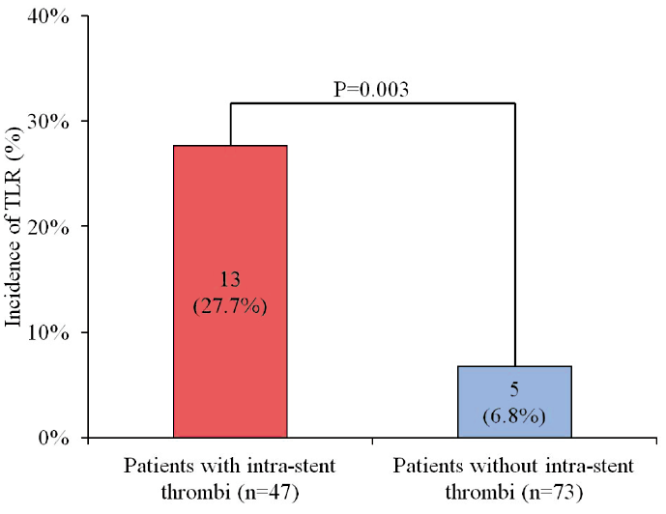
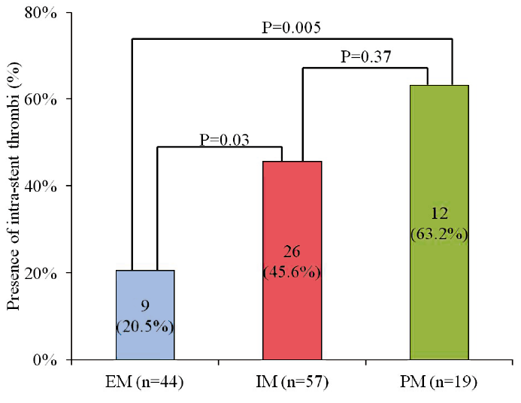
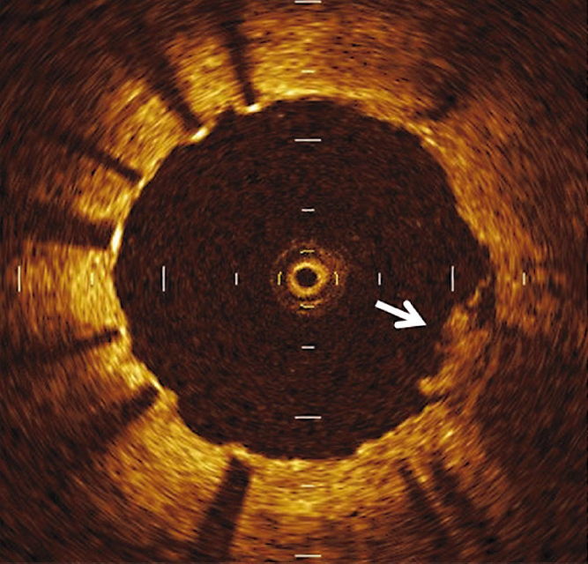
CYP2C19 SNP on Intra-stent Thrombi and TLR
  Follow-up OCT imaging in DES-treated Patients on DAPT (n = 125)
Nishio R, et al. Circ J 2012;76:2348-55.

Slide 26
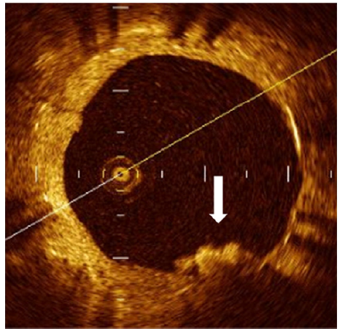
Predictors of TLR after DES Implantation
Konishi A, et al. Int J Cardiol 2015;179:476-83.

Slide 27
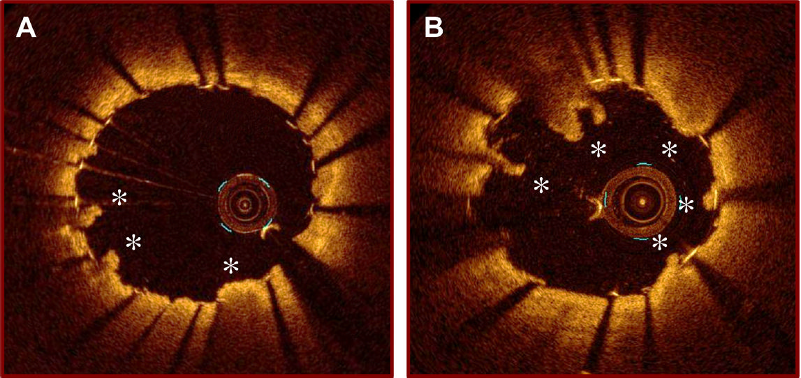
Reduction of In-stent Thrombus After PCI
OCT Study Prasugrel Clopidogrel
Kubo T, et al. J Cardiol 2015;e-pub.

Slide 28
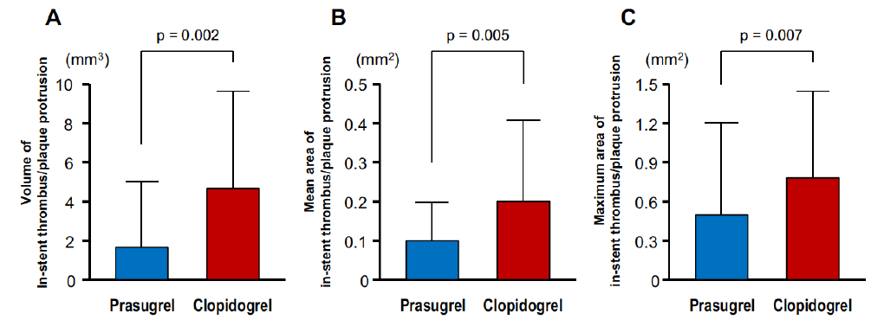
Reduction of In-stent Thrombus After PCI
In-stent thrombus & plaque protrusion
? Role of prasugrel on neointimal hyperplasia
Kubo T, et al. J Cardiol 2015;e-pub.

Slide 29
Role of Platelet in CV Disease Entities
Endothelial Function
Atherosclerosis & Restenosis
Wound Healing & Remodeling
Adenosine-related Effect
Notes:
29

Slide 30
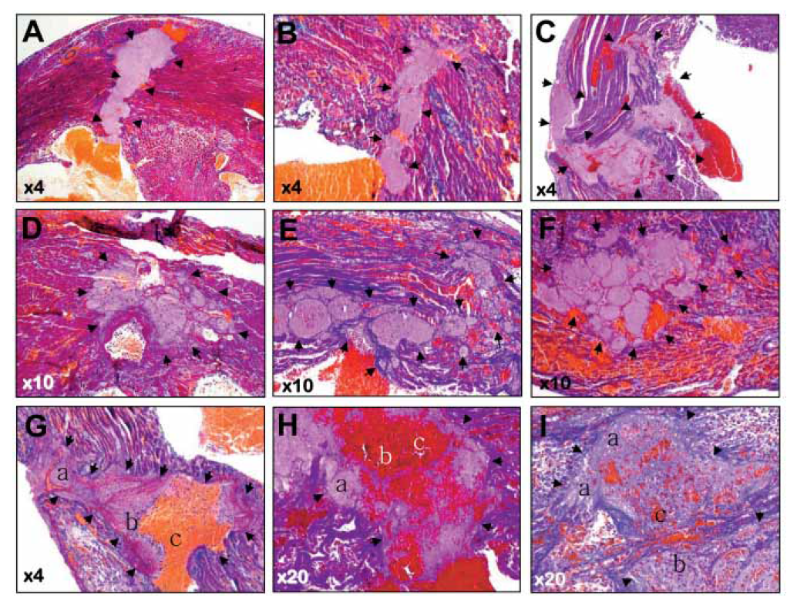
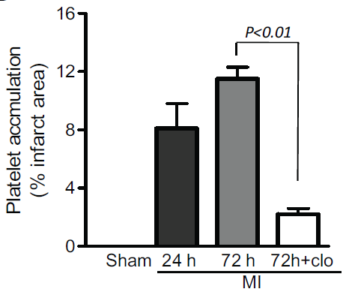
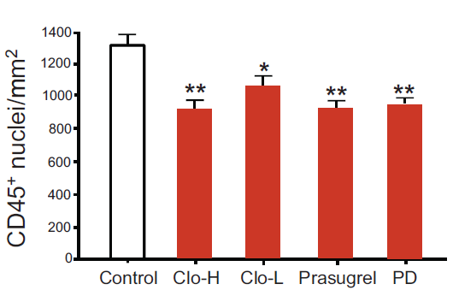
Role of Platelets in Inflammatory Responses for Post-MI LV Remodeling
  Platelet-Leukocyte Accumulation in Infarcted Myocardium (C57BL/6 mice)
Randomized treatment started 2 hrs after MI and lasted for 3 days
Low-dose clopidogrel (15/5/5 mg/kg) vs. High-dose clopidogrel (50/15/15 mg/kg) vs. Prasugrel (5/5/5 mg/kg) vs. PD (platelet depletion) by CD41 antibody
Liu Y, et al. ATVB 2011;31:834-41.
Notes:
Platelets bind LDL in blood, are activated and
adhere to the endothelium, predominantly at bifurcation sites. Adhering platelets alter endothelial function and recruit progenitor cells/monocytes. These cells
are able to phagocytoze LDL-laden platelets and migrate into the intima of the vessel wall where they develop into macrophages. Native LDL (orange) is modified
to oxidized LDL (yellow) by endothelial cells and smooth muscle cells in the intima but also by platelets and monocytes outside the vessel wall. Both macrophages
and platelets express scavenger receptors that bind OxLDL. At lesion prone sites, OxLDL diffuses passively through the functionally altered endothelium, but
OxLDL is also transported into the intima by platelets after scavenger receptor-mediated uptake. All illustrated OxLDL transport pathways result in transformation
of macrophages into foam cells, the main component of fatty streaks and atheromatous plaques. Specific inhibitors, such as the immunoadhesin CD68-Fc,
are able to block several steps in foam cell formation.
30

Slide 31
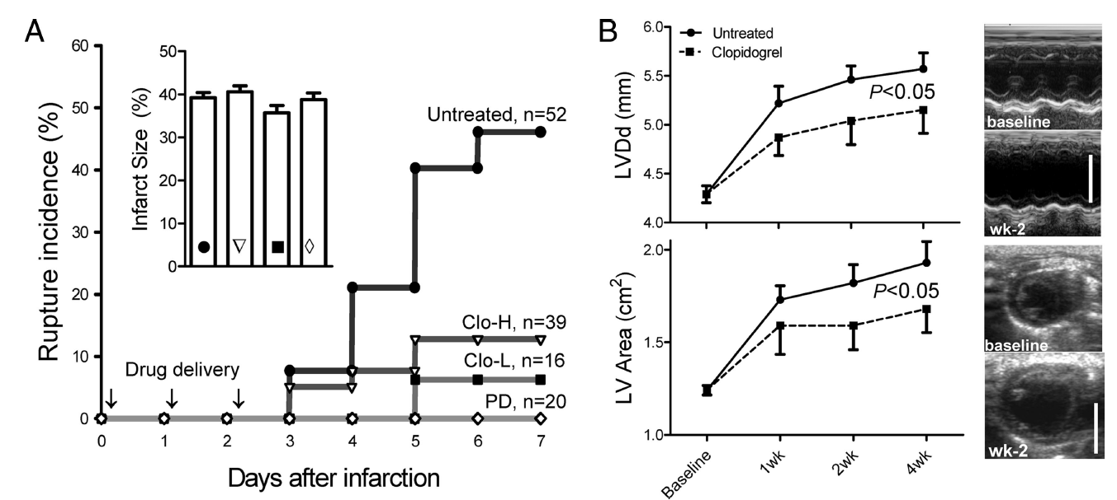
Role of Platelets for Post-MI LV Remodeling
  Platelet-Leukocyte Accumulation in Infarcted Myocardium (C57BL/6 mice)
Randomized treatment started 2 hrs after MI and lasted for 3 days
Low-dose clopidogrel (15/5/5 mg/kg) vs. High-dose clopidogrel (50/15/15 mg/kg) vs. Prasugrel (5/5/5 mg/kg) vs. PD (platelet depletion) by CD41 antibody
Acute phase: LV rupture Chronic phase: LV remodeling
Liu Y, et al. ATVB 2011;31:834-41.
Notes:
Platelets bind LDL in blood, are activated and
adhere to the endothelium, predominantly at bifurcation sites. Adhering platelets alter endothelial function and recruit progenitor cells/monocytes. These cells
are able to phagocytoze LDL-laden platelets and migrate into the intima of the vessel wall where they develop into macrophages. Native LDL (orange) is modified
to oxidized LDL (yellow) by endothelial cells and smooth muscle cells in the intima but also by platelets and monocytes outside the vessel wall. Both macrophages
and platelets express scavenger receptors that bind OxLDL. At lesion prone sites, OxLDL diffuses passively through the functionally altered endothelium, but
OxLDL is also transported into the intima by platelets after scavenger receptor-mediated uptake. All illustrated OxLDL transport pathways result in transformation
of macrophages into foam cells, the main component of fatty streaks and atheromatous plaques. Specific inhibitors, such as the immunoadhesin CD68-Fc,
are able to block several steps in foam cell formation.
31

Slide 32
Novel Role of Platelet Reactivity and Inflammation in LV Remodeling Following STEMI
  REMODELING Study: PPCI-treated STEMI Patients on ASP+CLPD (n = 150)
LV Remodeling: a relative >20% increase in LV EDV between baseline and 1-month F/U
Park YH, Jeong YH, et al. Thromb Haemos 2017;in press.
TICA PRAS
Notes:
32

Slide 33
Predictors of LV Remodeling: Platelet & Inflammation
  REMODELING Study: The first human study for role of platelet in LVR
Park YH, Jeong YH, et al. Thromb Haemos 2017;in press.
Notes:
33

Slide 34
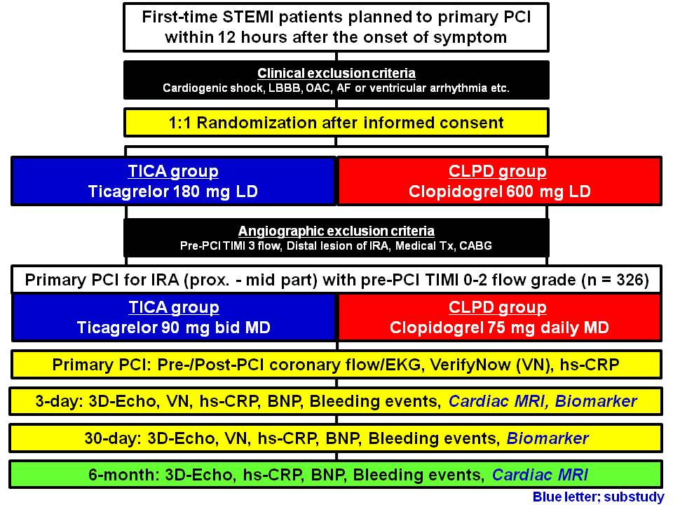
HEALING-AMI: The First RCT of Ticagrelor for LVR
  Enrollment will be finished in June-2017.
Notes:
34

Slide 35

PANDORA’S BOX

Slide 36
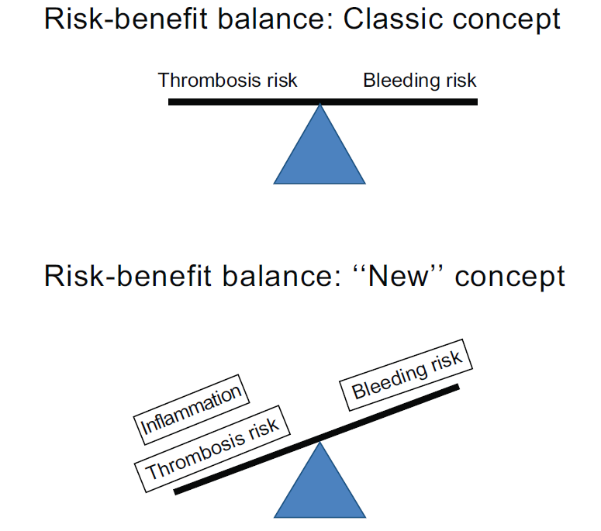
Antiplatelet Therapy: Balance btw Risk & Benefit
“Classic Concept”
Repair Inflammation Vasoprotection
“New Concept”
Notes:
36

