Slide 1
The Future of Percutaneous Treatment For Mitral Valve Disease
E Murat Tuzcu, MD
Professor of Medicine
Chief Academic Officer
Chief, Cardiovascular Medicine
Cleveland Clinic Abu Dhabi
No financial COI

Slide 3
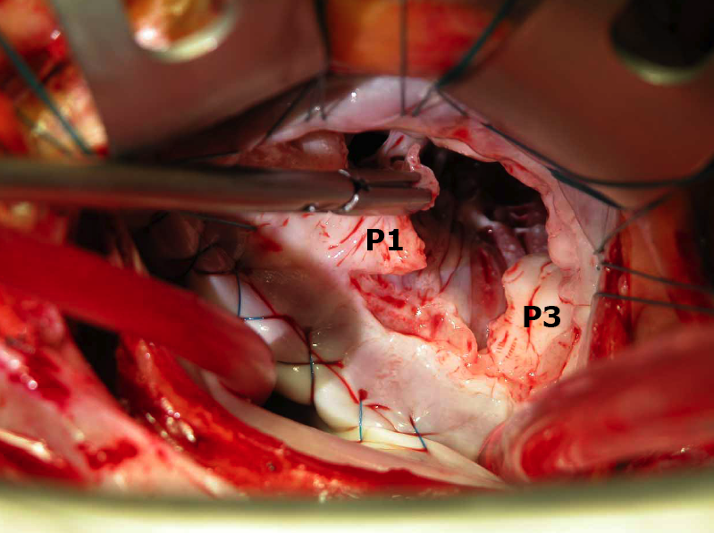
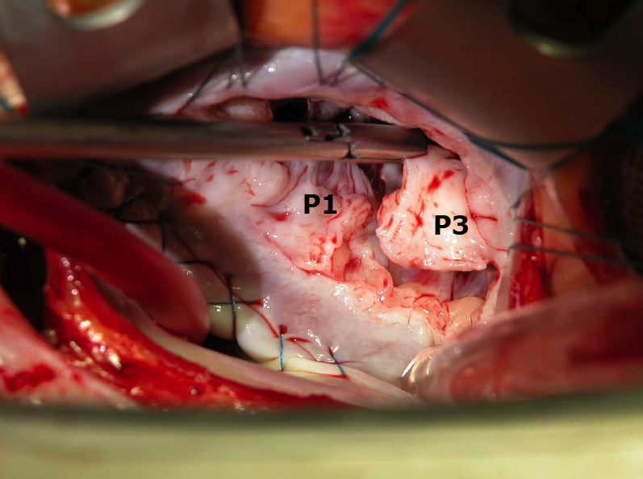
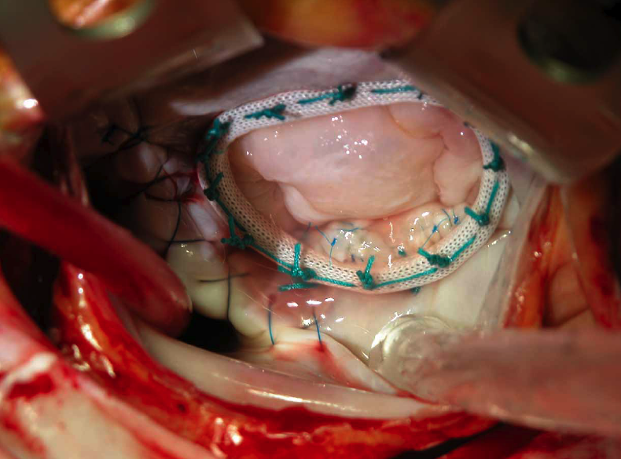
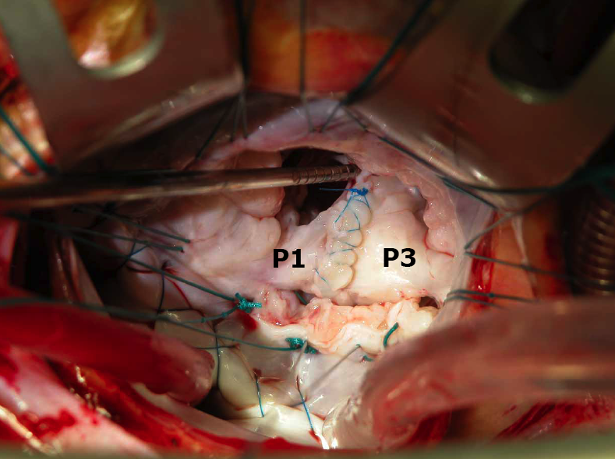

Slide 4
Degenerative Mitral Valve Repair: 10 year Outcome
100
95
90
85
80
75
(830)
100
95
90
85
80
75
(534)
(283)
(185)
(83)
98.7%
96.9%
92.9%
Percent Free of Reoperation
Percent of Patients in Each Category
Alive without reoperation
Reoperation
Death before reoperation
0
1
2
3
4
5
6
7
8
9
10
0
1
2
3
4
5
6
7
8
9
10
Interval (years) after repair
Interval (years) after repair
Gillinov et al, The Journal of Thoracic and Cardiovascular Surgery, 1998

Slide 5
MV Surgery: Impact ofAge and Comorbidities
Outcomes
Characteristics | < 50 yrs | 50-59 yrs | 60-69 yrs | 70-79 yrs | ≥ 80 yrs
Sample Size | 4315 | 5037 | 8472 | 11144 | 2720
Complications (%) | 13.51 | 17.79 | 23.11 | 29.47 | 35.48
Permanent stroke(%) | 1.23 | 1.79 | 2.70 | 4.16 | 4.52
Reoperation for bleeding (%) | 3.75 | 4.61 | 5.21 | 6.74 | 8.53
Renal failure (%) | 3.87 | 5.74 | 8.23 | 11.28 | 15.22
Deep sternal wound infection (%) | 0.44 | 0.75 | 0.74 | 0.68 | 0.51
Length of stay (d)
Mean (SD) | 11.43 (12.23) | 12.36 (13.52) | 13.32 (13.20) | 15.18 (14.66) | 16.31 (14.13)
Postoperative length of stay (d)
Mean(SD) | 8.71 (9.74) | 9.69 (11.04) | 10.58 (11.37) | 12.21 (13.11) | 13.22 (13.17)
Operative mortality (%) | 4.08 | 5.46 | 7.91 | 12.19 | 16.99
Older age associated w/
Higher mortality (x3)
Higher morbidity (x3)
Longer LOS (x1.5)
Mehta et al. Ann Thorac Surg 2002;74:1459-67
Notes:
4
4
This is the Bulleted List slide.
To create this particular slide, click the NEW SLIDE button on your toolbar and choose the BULLETED LIST format. (Top row, second from left)
The Sub-Heading and footnote will not appear when you insert a new slide. If you need either one, copy and paste it from the sample slide.
If you choose not to use a Sub-Heading, let us know when you hand in your presentation for clean-up and we’ll adjust where the bullets begin on your master page.
Also, be sure to insert the presentation title onto the BULLETED LISTMASTER as follows:
Choose View / Master / Slide Master from your menu.
Select the text at the bottom of the slide and type in a short version of your presentation title.
Click the SLIDE VIEW button in the lower left hand part of your screen to return to the slide show. (Small white rectangle)

Slide 6
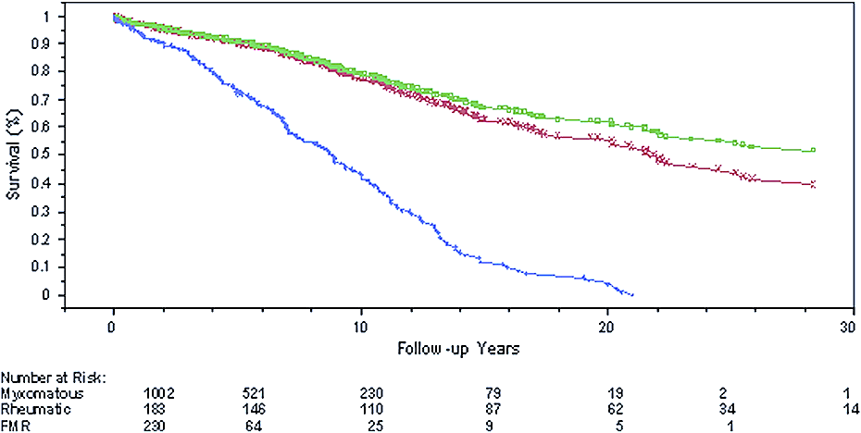
Outcome of Mitral Valve Repair Functional vs. Degenerative
Myxomatous
FMR
Rheumatic
DiBardino DJ, J Thorax Cardiovascular Surg. 2010; 139(1):76-83

Slide 7
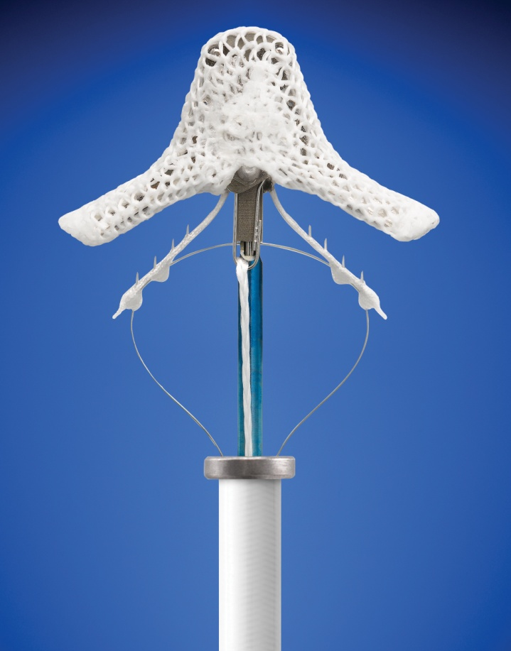
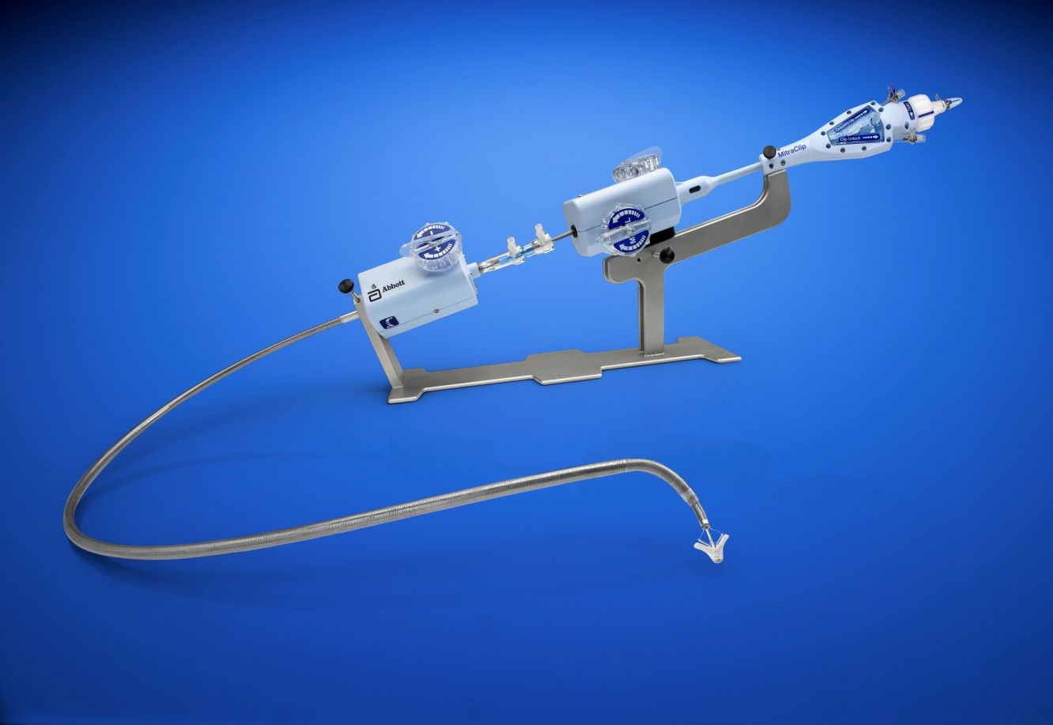
The MitraClip System
MitraClip Device (Clip)
MitraClip System
Arm
Clip Delivery System
Steerable Guide Handle
Delivery
Catheter
Handle
Gripper
Stabilizer
Steerable Guide, Steerable Sleeve, and Delivery Catheter
MitraClip Device (Clip)
Notes:
6

Slide 8
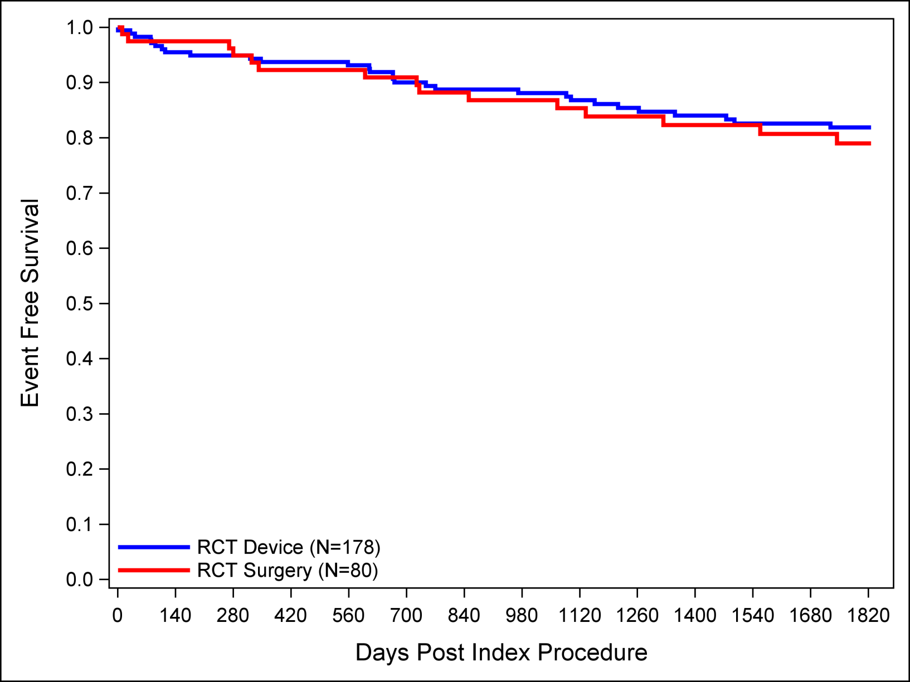
Kaplan-Meier Freedom From Mortality
EVEREST II RCT
MitraClip (N=178)
Surgery (N=80)
93.7% 92.3%
1 year
81.2% 79.0%
5 years
Mauri et al. JACC 2013;62:2013-17

Slide 9
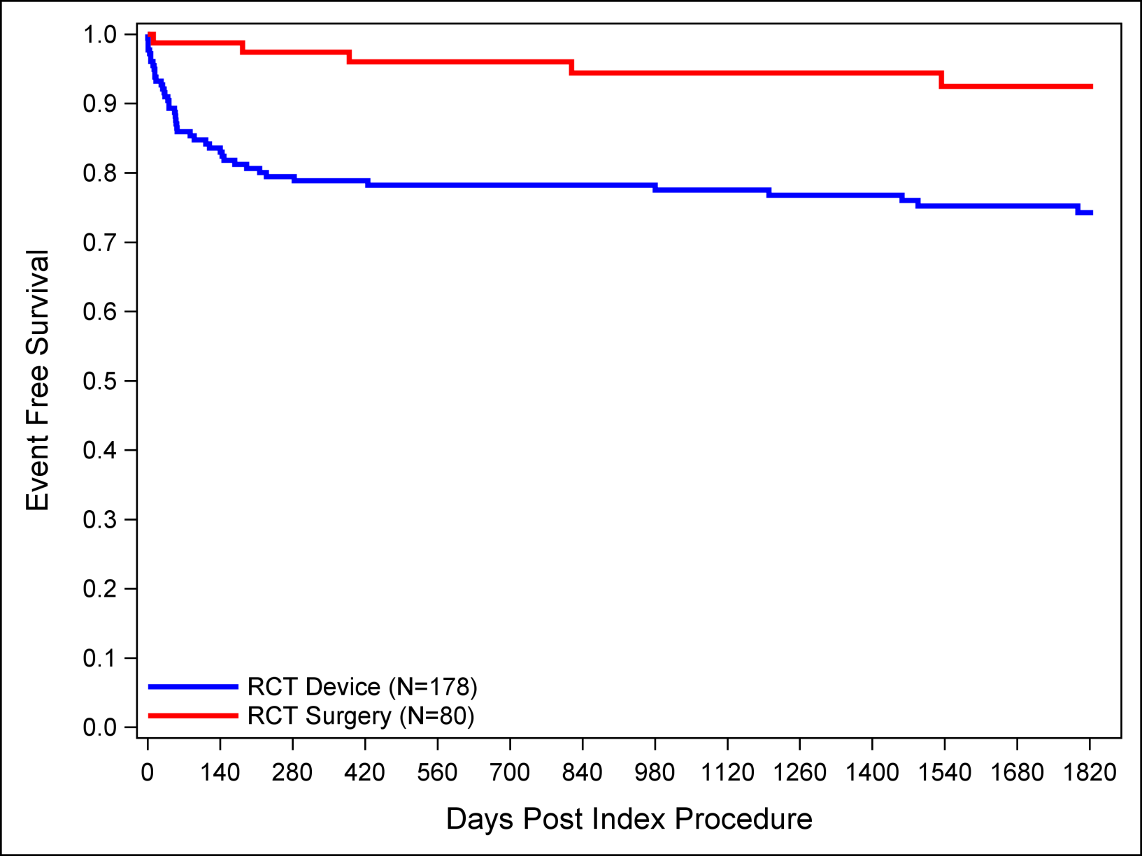
Kaplan-Meier Freedom From MV Surgery in MitraClip Group or Re-operation in Surgery Group
Surgery (N=80)
MitraClip (N=178)
78.9% 97.4%
1 year
74.3% 92.5%
5 years
EVEREST II RCT
Mauri et al. JACC 2013;62:2013-17

Slide 10
NYHA Functional Class EVEREST II RCT All Treated Patients (N=258)
MitraClip (N=178)
NYHA I/II at 1 and 5 Years
Surgery (N=80)
NYHA I/II at 1 and 5 Years
p < 0.005
p < 0.005
p < 0.005
p < 0.005
98%
91%
88%
98%
I
I
I
I
II
I
II
I
II
I
I
II
III
III
III
II
II
III
II
II
IV
IV
III
IV
III
IV
Baseline
1 Year
Baseline
5 Years
Baseline
1 Year
Baseline
5 Years
N=151
N=106
N=66
N=42
N = survivors with paired data; p-values for descriptive purposes only

Slide 11
COAPT Trial
430 patients at up to 75 US sites
Significant FMR (≥3+ by core lab)
Symptomatic heart failure subjects who are treated per standard of care
Determined by the site’s local heart team as not appropriate for mitral valve surgery
Specific valve anatomic criteria
Randomize 1:1
Control group
Standard of care
MitraClip
N=215
N=215
Clinical and TTE follow-up:
Baseline, Treatment, 1-week (phone), 1, 6, 12,
18, 24, 36, 48, 60 months
1⁰ EP: CHF hospitalizations (Effectiveness) + Safety 1⁰ EPs

Slide 12
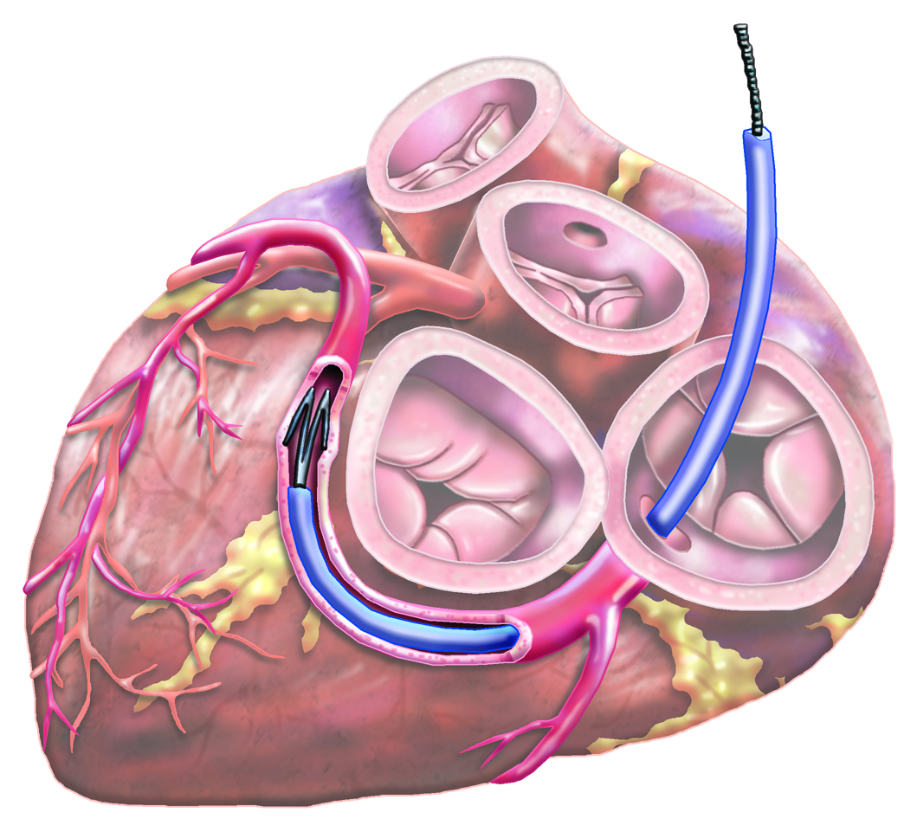
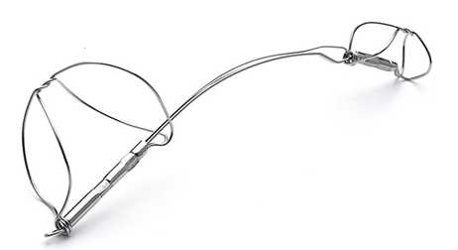
Coronary Sinus- Indirect Annuloplasty
CARILLON Mitral Contour System

Slide 13
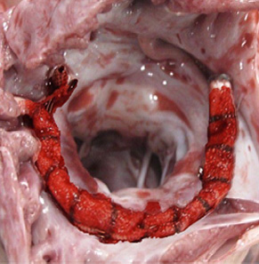
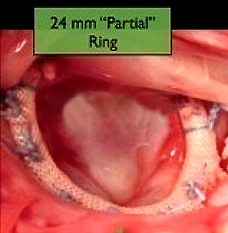
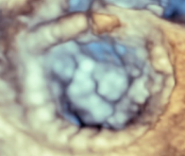
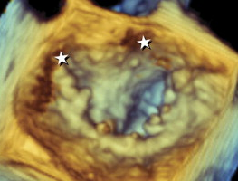
“Surgical Results Delivered Via Catheter”
Cardioband percutaneously implanted
in a pig
Standard Annuloplasty
(open heart surgery)
TEE patient
TEE Commercial band
Notes:
Show model
12

Slide 14
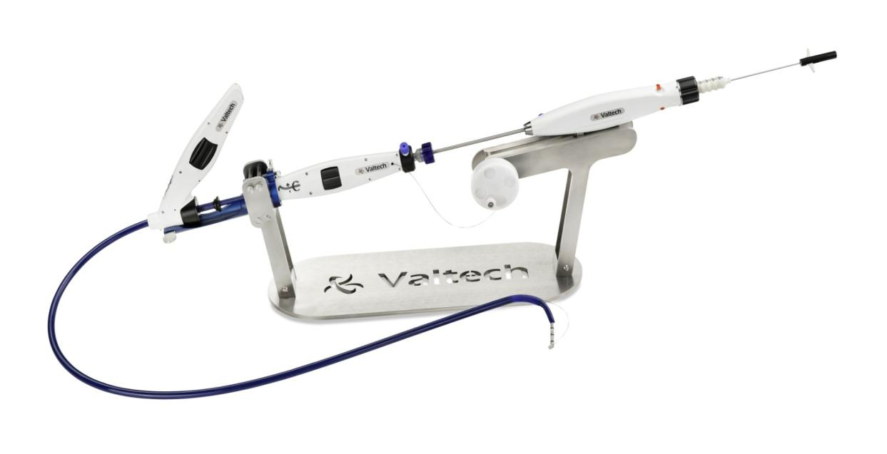
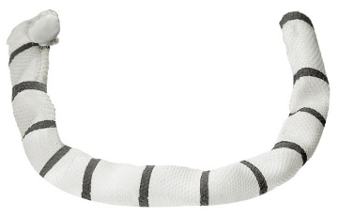
Percutaneous Direct Annuloplasty with the Adjustable Cardioband
Surgical band delivered via transfemoral venous access
Implanted on the supra-annular position, similar to the surgical treatment
Bi-lateral controlled adjustment of the posterior annulus for optimal hemodynamic results
FIM procedure (F. Maisano)

Slide 15
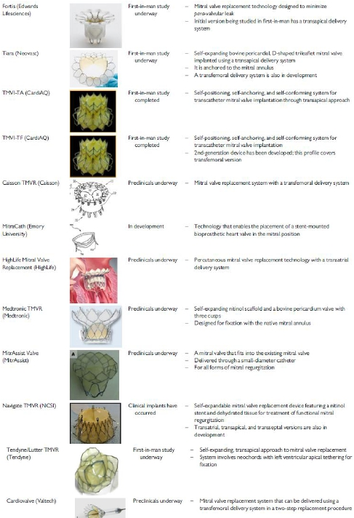
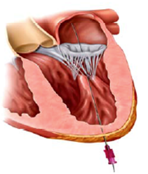
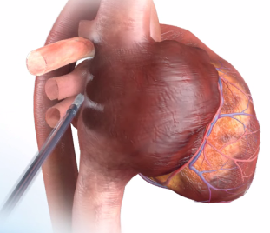
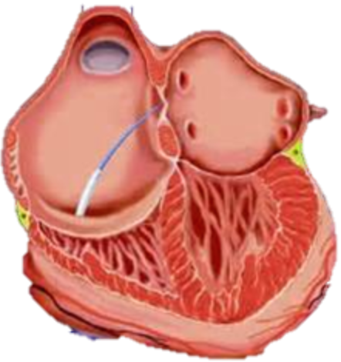
Transcatheter Mitral Valve Replacement
TA
Tat
TS
Maisano EHJ 2015

Slide 16
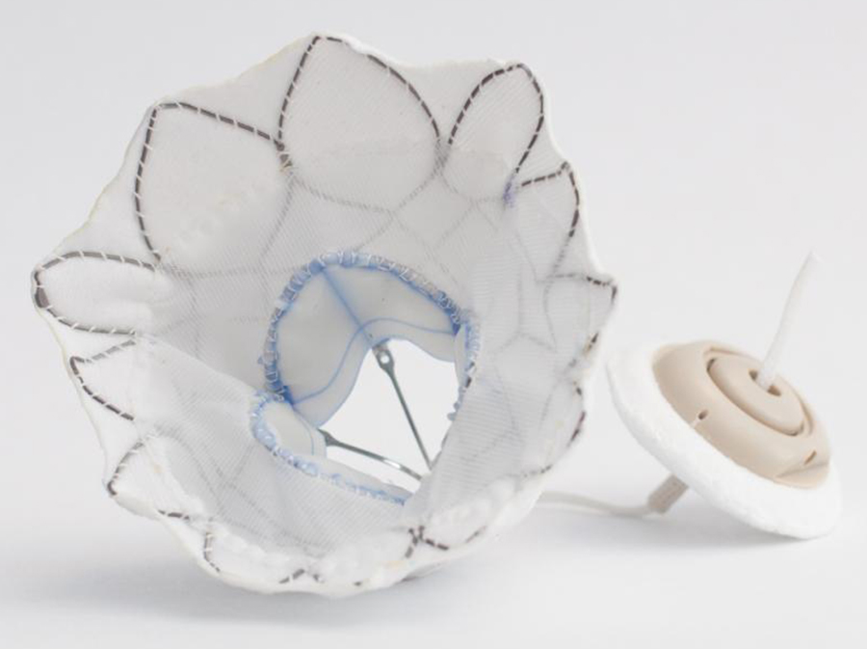
TENDYNE
Porcine leaflets
Anatomically (D) shaped
Nitinol, self-expanding
Large outer frame
Valve tether to apex

Slide 17
TENDYNE

Slide 18
TENDYNE

Slide 19
TENDYNE

Slide 21
TMVR - Tendyne Feasibility Study
Outcome | N=30
Death (all cause) | 1 (3.3%)
Cardiac | 0 (0%)
Non-cardiac | 1 (3.3%)
CVA | 0 (0%)
MV surgery | 0 (0%)
Re-hospitalisation
Heart failure | 4 (13.8%)
LVAD/transplant | 0 (0%)
Other (ileus) | 1 (3.3%)
Device-related
Hemolysis, transfusion | 1 (3.3%)
Leaflet thrombosis | 1 (3.3%)
Muller D. TCT 2016

Slide 22
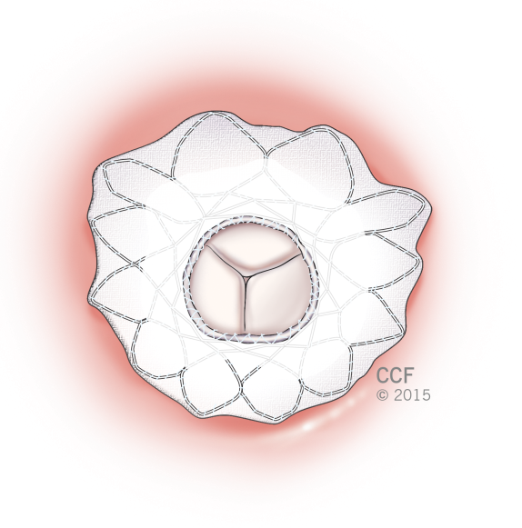
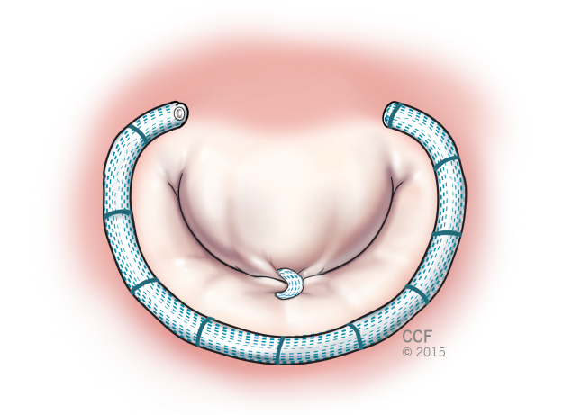
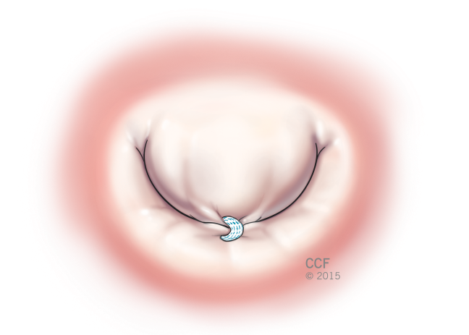
FUNCTIONAL MITRAL VALVE DISEASE
Valve Replacement
Apical
Tethering
Leaflet Repair
Valve Replacement
Annuloplasty
+
Leaflet Repair
Leaflet Restriction
Posterior
Tethering
Annuloplasty
4.0
5.0
6.0
Mitral Valve Size (cm²)
Tuzcu and Kapadia EHJ 2016

Slide 23
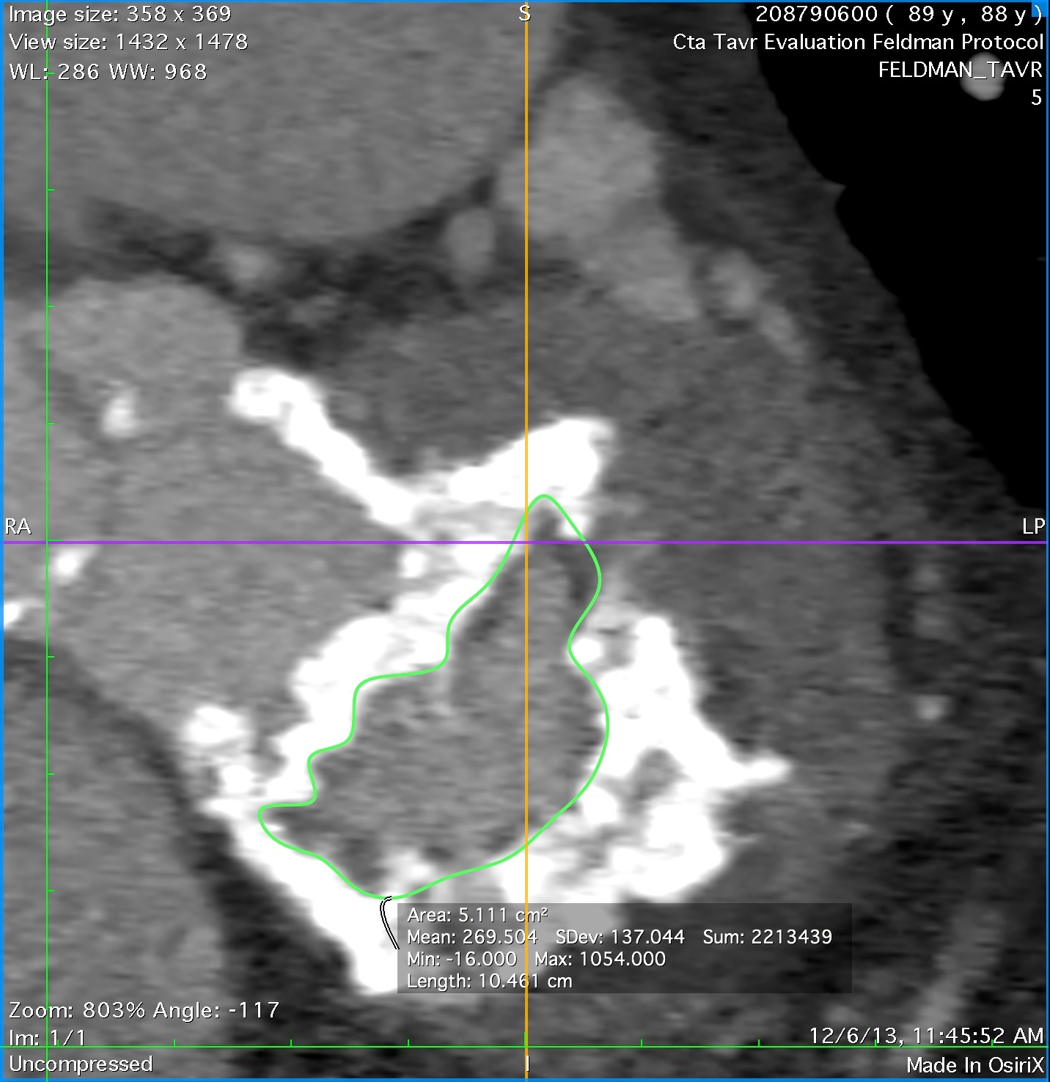
Calcific Mitral Stenosis
Guerrero TCT 2015

Slide 24
Transcatheter Mitral Valve Replacement
Valve in Ring (Edwards Sapien)

Slide 25
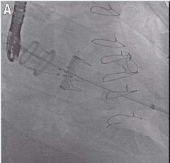
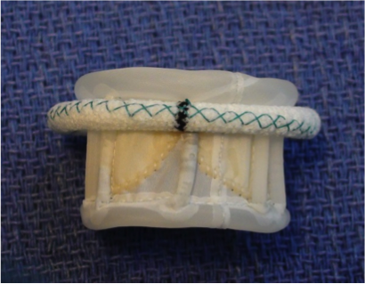
Transcatheter Mitral Valve Replacement
Valve in Valve (Direct Flow Medical)
Left atrium
Left ventricle

Slide 26
TMVR ViV and ViR Procedural characteristics
 | Total n=437 | Mitral Valve-in-Valve n=349 | Mitral Valve-in-Ring n=88 | P Value
Major stroke | 2.5% | 2.9% | 1.1% | 0.33
Acute kidney injury (VARC II/III) | 14.4% | 10.6% | 29.5% | <0.001
30-day Death | 8.5% | 7.7% | 11.4% | 0.15
30-day Cardiovascular death | 6.9% | 6% | 10.2% | 0.62
Dvir TCT 2015

Slide 27
TMVR - Challenges
Varied pathophysiology
A range of annulus sizes
Differing degrees of Ca
Complex 3-D annulus
Complex sub-valvar tissue
LV size, geometry, Fx varies
A dynamic high pressure environment
Safe and accurate implantation
Fixation issues, migration
LVOT obstruction
Paravalvar leaks
Areas of stasis, thrombotic risk
Impact on subvalvar apparatus and LV
Safe and accurate implantation

