Slide 1
Korea Made Coronary Devices:
Present and Future
JCR2016
Taehoon Ahn, MD, PhD, FSCAI, FACC
Gachon University Gil Medical Center
Incheon, South Korea

Slide 2
Disclosure
Conflict of interest: Nothing to report

Slide 3
Contents:
1
Global and Domestic Drug-eluting stent market/development Outlook
2
Current situation of Korea made drug-eluting stents in Korea
3
Future of Korea made coronary products in Korea

Slide 4
Global medical equipment market outlook
Unit: Bill $,%
 | 2010 | 2011 | 2012 | 2013 | 2014 | 2015 | 2016 | 2017 | 2018 | 2019
North/ South America | 1,263 | 1,372 | 1,394 | 1,457 | 1,546 | 1,641 | 1,753 | 1,872 | 2,000 | 2,139
Asia / Pacific | 523 | 601 | 670 | 677 | 723 | 774 | 844 | 922 | 1,011 | 1,116
Western Europe | 761 | 823 | 792 | 848 | 880 | 885 | 900 | 947 | 997 | 1056
Central and Eastern Europe | 156 | 179 | 188 | 176 | 171 | 179 | 189 | 203 | 217 | 232
Middle East / Africa | 60 | 68 | 74 | 80 | 83 | 91 | 100 | 111 | 122 | 136
Total | 2,763 | 3,043 | 3,117 | 3,238 | 3,403 | 3,571 | 3,785 | 4,054 | 4,348 | 4,678
출처:BMI Espicom, Worldwide Medical Market Forecasts to 2019,2014.9
출처:한국보건산업진흥원, 2014년 의료기기산업 분석 보고서 2014

Slide 5
Medical equipment market situation in Korea
Unit: Mill \ ,%
 | Production | Export | Income | Market | Share of Income
2010 | 2,964,445 | 1,681,619 (1,454,361) | 2,619,895 (2,265,836) | 3,902,720 | 67,1
2011 | 3,366,462 | 1,853,785 (1,672,925) | 2,793,709 (2,521,148) | 4,306,387 | 64,9
2012 | 3,877,374 | 2,216,074 (1,966,557) | 2,931,014 (2,600,999) | 4,592,314 | 63,8
2013 | 4,224,169 | 2,580,862 (2,356,866) | 2,988,241 (2,728,888) | 4,631,538 | 64,5
2014 | 4,604,814 | 2,714,058 (2,576,914) | 3,084,204 (2,928,357) | 4,974,960 | 62,0
( ):one thousand dollar
KFDA 2015.05.13

Slide 6
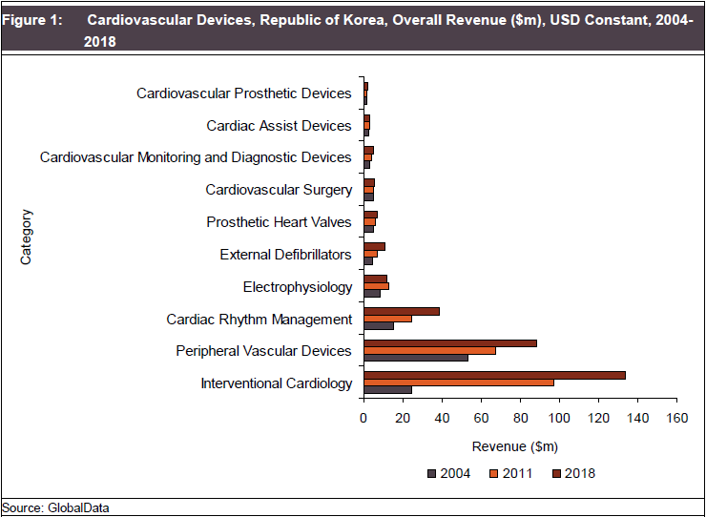
Cardiovascular Devices in Korea

Slide 7
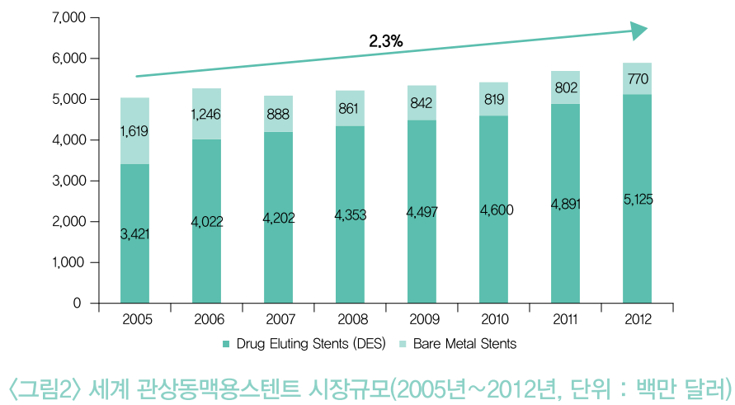
Global DES Market
(Million dollars)

Slide 8

DES usage trends by year in Korea (HIRA 2015)

Slide 9

















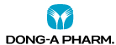




STENT Manufacturers in Korea
Global Big Com.
Korean Small Com.
Korean Big Com.
DIO
M&A
M&A
M&A
M&A
Korea cardiovascular stent research institute
1991
2012

Slide 10
Drug-eluting Stent Market Outlook in Korea vs. Japan
35%
(Xience Alpine, Synergy, Resolute Integrity)
98.1%
65%
(Nobori, Ultimaster)
2015
2015

Slide 11
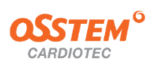
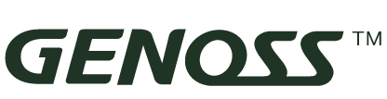




Stent Platforms available in Korea
Domestic DES Global DES
Item
Company
DES
Cell Design
Stent Material
Strut Thickness
Crossing Profile
DXR | Genoss | SALVUS | Xience Prime /Alpine | Synergy | Resolute Integrity /Onyx | BioMatrix Flex
Semi-open cell | Semi-open cell | Semi-open cell | Semi-open cell | Semi-open cell | Semi-open cell | Semi-open cell
L605 CoCr alloy | L605 CoCr alloy | L605 CoCr alloy + TiO₂ | L605 CoCr alloy | L605 PtCr alloy | L606 CoCr alloy | 316L Stainless steel S-stent
77㎛ | 70㎛ | 75um | 81㎛ | 81㎛ | 91㎛ | 120㎛
1.04mm | 1.0mm | 1.07mm | 1.08mm | 1.07mm | 1.0mm | 1.11mm

Slide 12
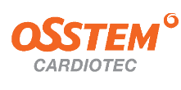


Stent Platforms available in Korea
Domestic DES Global DES
Item
Company
DES
Polymer
Drug
Coating
DXR | Genoss | SALVUS | Xience Prime /Alpine | Synergy | Resolute Integrity /Onyx | BioMatrix Flex
Degradable (PLGA) | Degradable (PLGA) + Parylene | Degradable (PLGA) | Non degradable (PVDF-HFP) | Degradable (PLGA) | Non degradable (BioLinx: (C10/C19/PVP blend) | Degradable (PLA)
Fast Re-endothelialization rate | Fast Re-endothelialization rate | Fast Re-endothelialization rate | Nomal Re-endothelialization rate | Fast Re-endothelialization rate | Nomal Re-endothelialization rate | Fast Re-endothelialization rate
Paclitaxel Cilostazol (Dual drug) | Sirolimus (Single drug) | Sirolimus (Single drug) | Everolimus (Single drug) | Everolimus (Single drug) | Zotarolimus (Single drug) | Biolimus A9 (Single drug)
Full coating | Abluminal coating | Semi-Abluminal coating | Full coating | Abluminal coating | Full coating | Abluminal coating

Slide 13

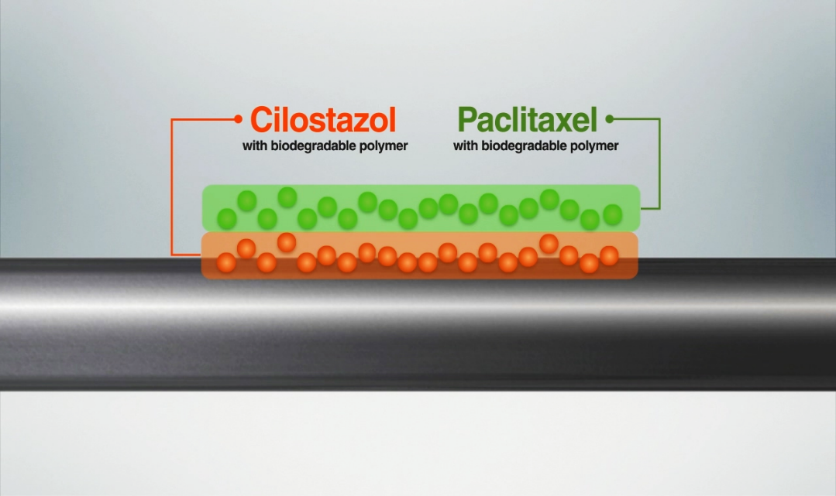
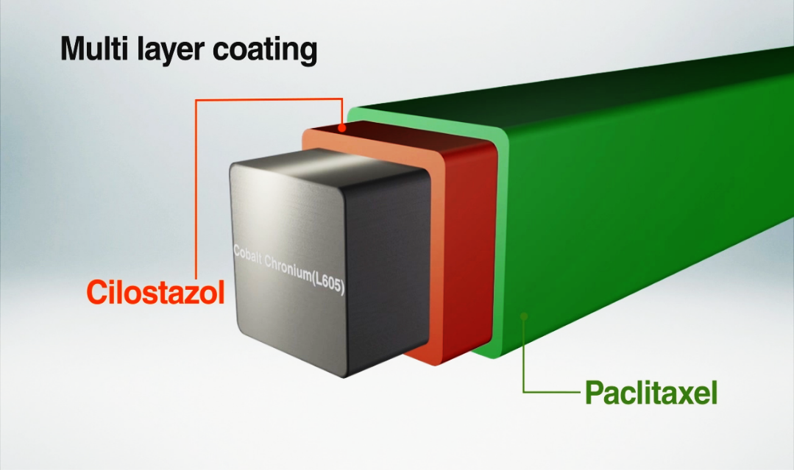
Cilotax ---DXR (Dual eXcellent Revolution)
Multi-layered Coating Structure
- Active Drug A: Paclitaxel (1.0ug/mm²)
  ► Inhibiting cell proliferation makes Lower Restenosis
- Active Drug B: Cilostazol (6.0ug/mm²)
  ► Anti platelet effect makes Lower Thrombosis

Slide 14

Stent | CILOTAX | DXR
Material | L605 Co-Cr Alloy (ASTM F90)
Cell Design | Semi-Open Cell
Coating Thickness | 13㎛ | 6㎛
Elastic Recoil | < 6% | < 6%
Longitudinal Compression | 0.380 mm | 0.260 mm
Longitudinal Tensile | 1.53 mm | 0.75 mm
Radial Force | 4.03 N | 4.26 N
Flexibility | 0.52 N | 0.38 N
Delivery System | CILOTAX | DXR
Balloon Material | Nylon Blend
Usable Catheter Length | 135 cm | 138 cm
Distal Shaft | 2.5 mm ~ 3.0 mm: 2.7 F 3.5 mm : 2.8 F | 2.5 mm ~ 3.0 mm: 2.6 F 3.5 mm : 2.7 F
Proximal Shaft | 2.0 F | 1.9 F

Slide 15
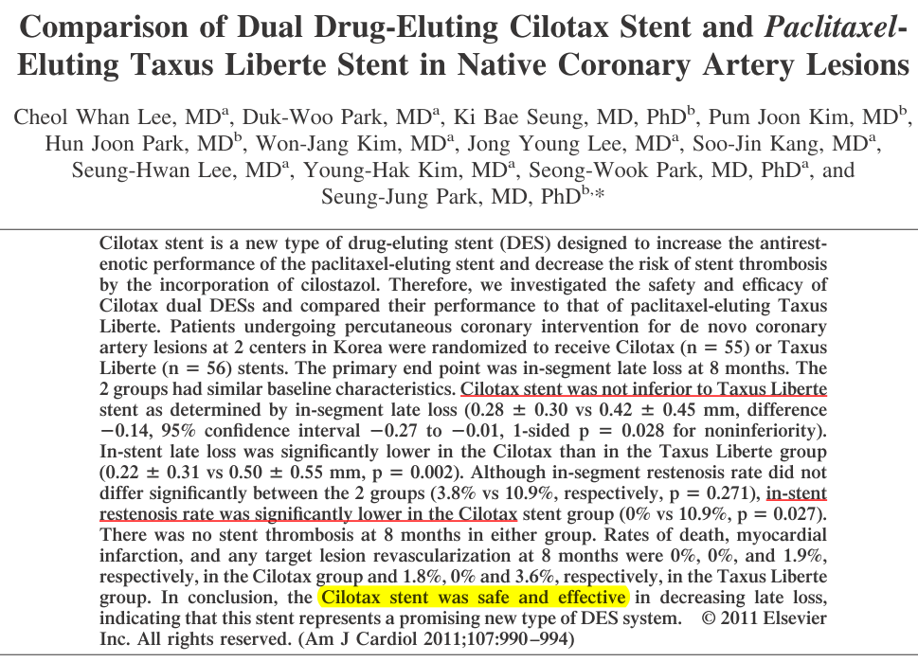
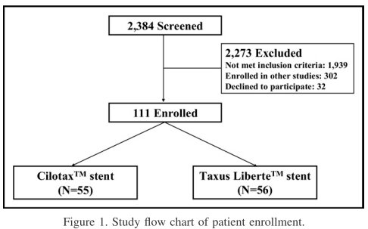
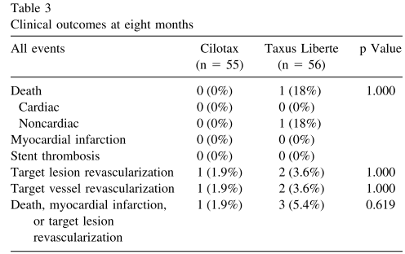
Landmark study of Cilotax for SAP

Slide 16
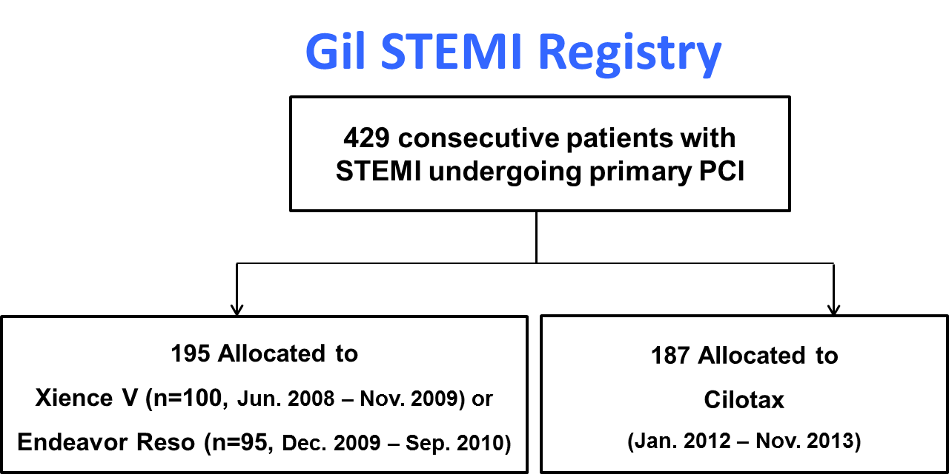
Clinical outcome of Cilotax in AMI
 | Cilotax (n=141) | Other 2nd generation (n=162) | P
MACEs, n (%) | 7 (5.0) | 4 (2.4) | 0.087
Cardiac death & MI, n (%) | 7 (5.0) | 4 (2.4) | 0.216
Cardiac death, n (%) | 2 (1.4) | 3 (2.2) | 0.682
Nonfatal MI, n (%) | 5 (3.5) | 1 (0.6) | 0.100
TLR, n (%) | 0 (0) | 1 (0.6) | 1.000
Definite stent thrombosis, n (%) | 4* (2.8) | 1⁺ (0.7) | 0.371
Inclusion criteria
- AMI with ST-segment elevation (≥ 20 minutes of chest pain and at least 2 mm of ST-segment elevation in at least two contiguous leads or a new left bundle-branch block) and
- Primary PCI with stent implantation (diameter stenosis >50%, ≥2.5 mm to ≤4.0 mm, de novo lesion in native coronary artery)
Exclusion criteria
- Thrombolytic therapy
- AMI caused by in-stent thrombosis or restenosis
- Cardiogenic shock
- Follow-up loss for 1 year
* Angiographic data was not evaluated yet.

Slide 17
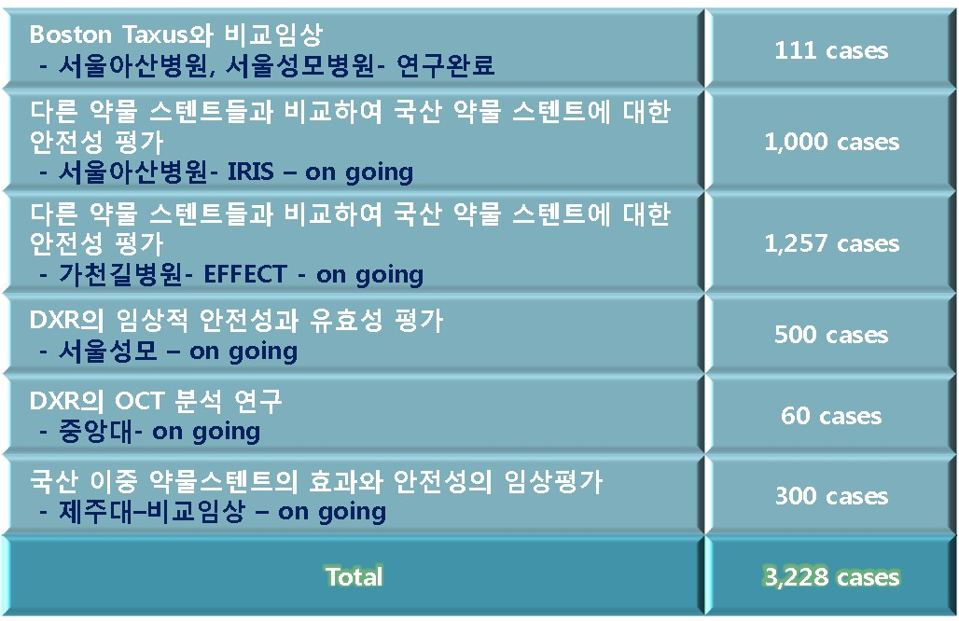
Current Status of Ongoing Clinical Studies

Slide 18
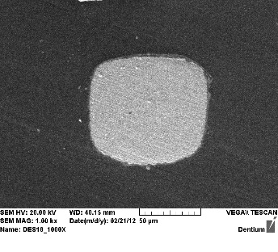
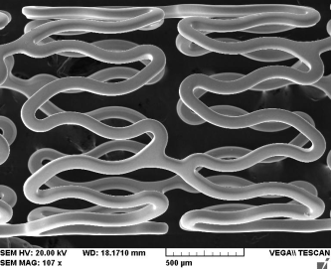
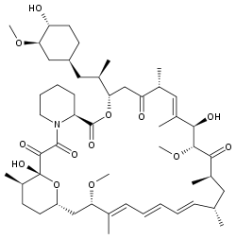
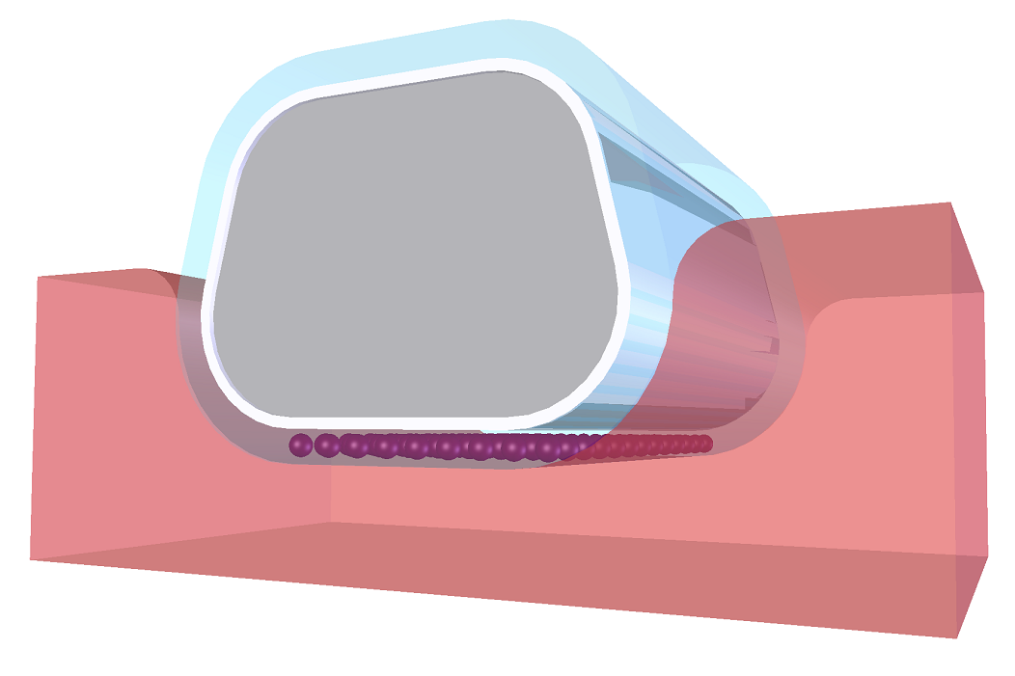
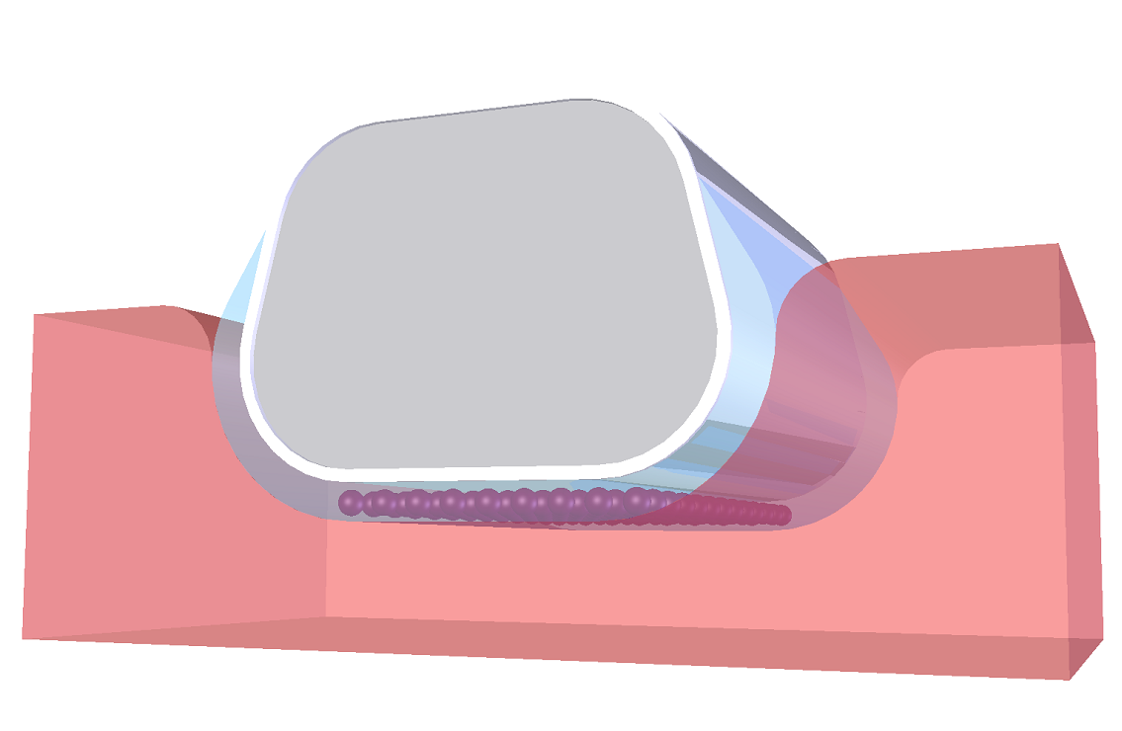
DES
Characteristics
1
Strut
2
Polymer
- Co-Cr Alloy L605
- Thickness 70-78µm
- Bioresorbable polymer
- Abluminal coating
- Coating thickness 4µm
Full coating
Abluminal coating
3
4
Drug
Balloon Catheter
- Sirolimus
- 1.15ug/mm²
- Low profile
- Good Flexibility, pushability
- Fast deflation

Slide 19
DES
First in Man Trial
- de novo Coronary lesion
- 20 years ≤ Age ≤ 80 years
- Stable angina, Unstable angina, Silent ischemia
- 2.5mm ≤ Vessel diameter ≤ 4.0mm
- Lesion length ≤ 40mm (overlapping 허용)
Randomization to 1 : 1 stratified by Sites
Total N=80
GenossTM
(n=40)
Promus ElementTM
(n=40)
Primary End Point : In-stent late lumen loss by QCA at 9 months

Slide 20
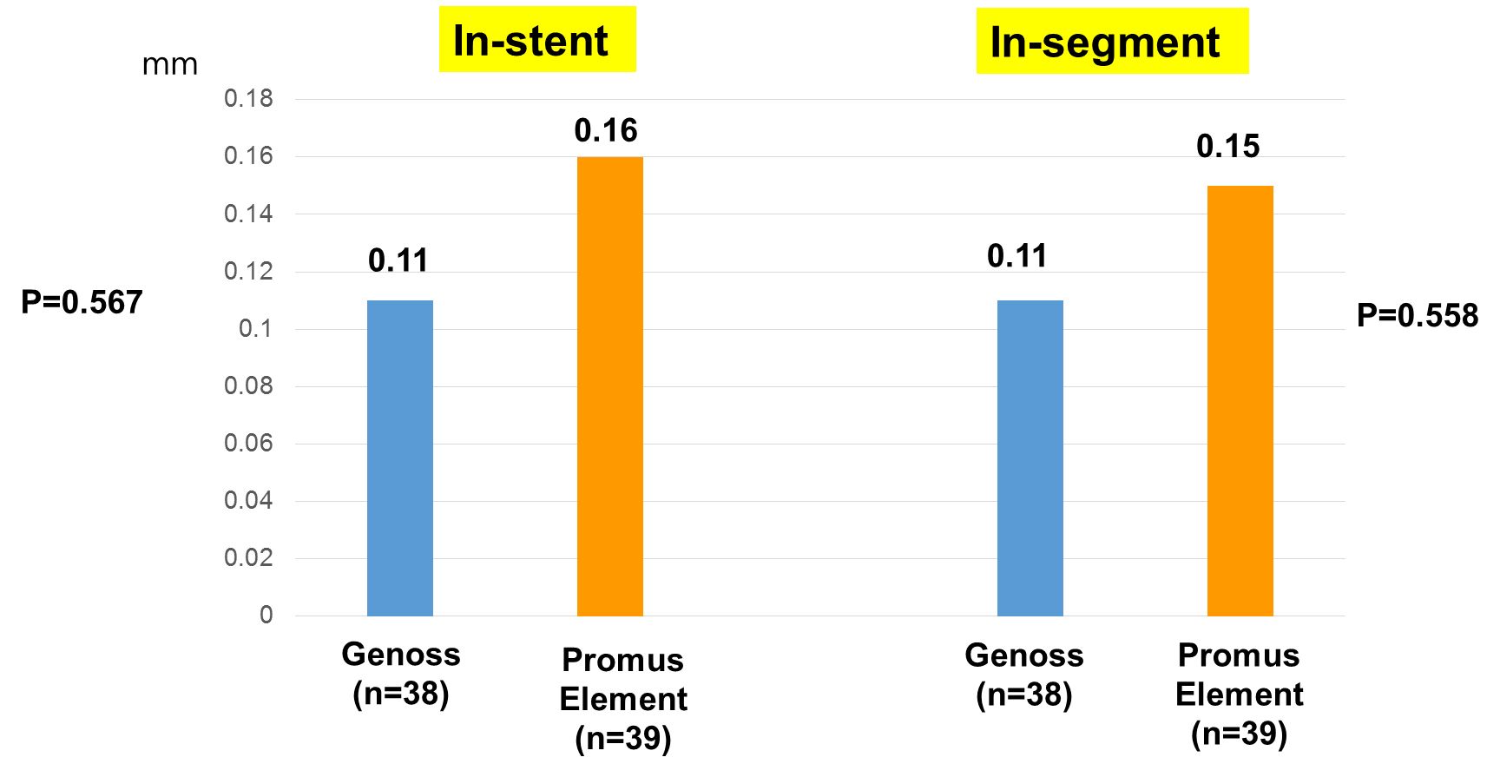
Genoss DES
Late Lumen Loss (9 mo)

Slide 21
1. Clinical trials progress (126 people completed)
SALVUS Study Overview
구 분 | 12M F/up | MACE | Withdrawal
A(SALVUS) | 100% (N=64) | 3 | 1
B(Biomatrix Flex) | 97% (N=62) | 5 | 0
12M F/up completed : 98.4%
F / up schedule completed
  9M F/up : Within the first week of September 2016
  12M F/up : Within the first week of December 2016
MACE occurrence status
  A(3 case) : TLR(3)
  B(5 case) : TLR(3)/TVR(2)
시험기기 : SALVUS / 대조기기 : BioMatrix FlexTM
Cut-off : 2016-12-10
Primary endpoint ( 9M late lumen loss): Jan/2017

Slide 22
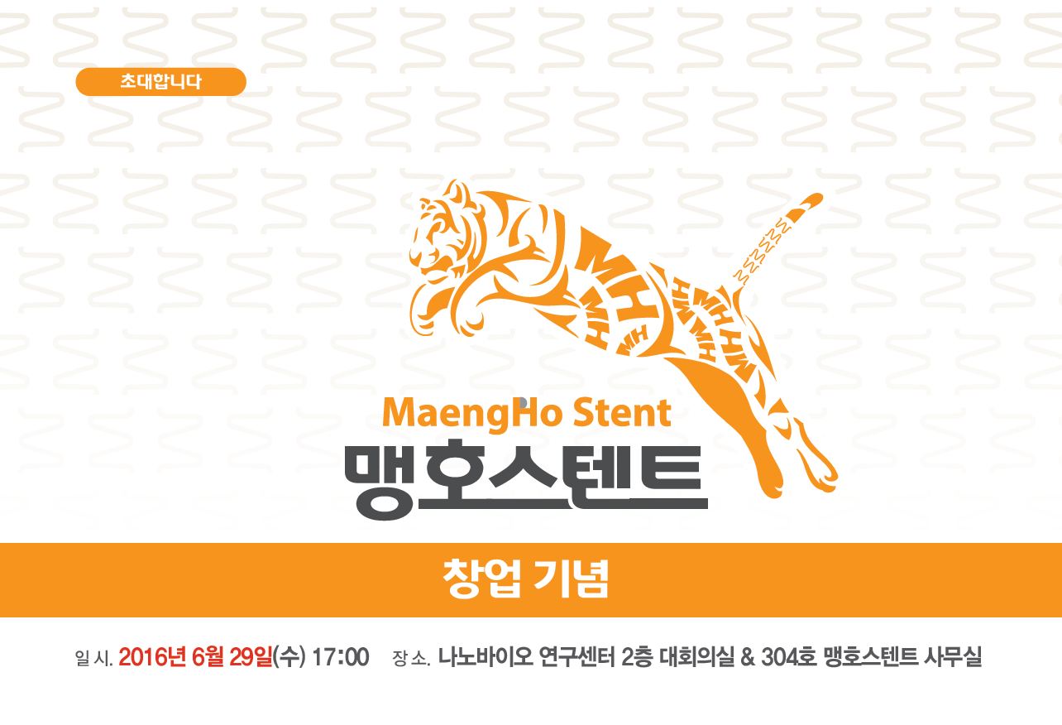
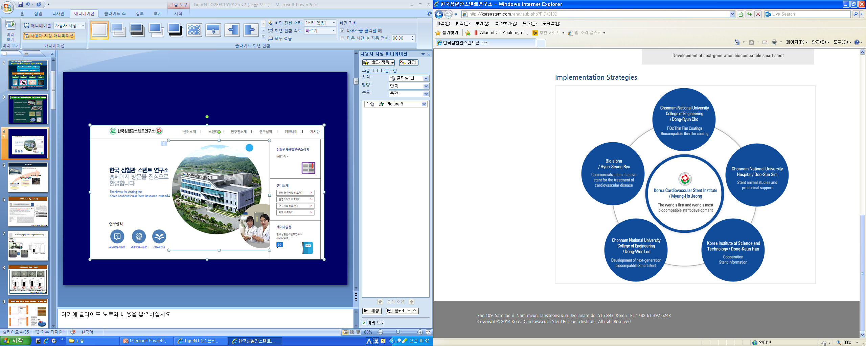
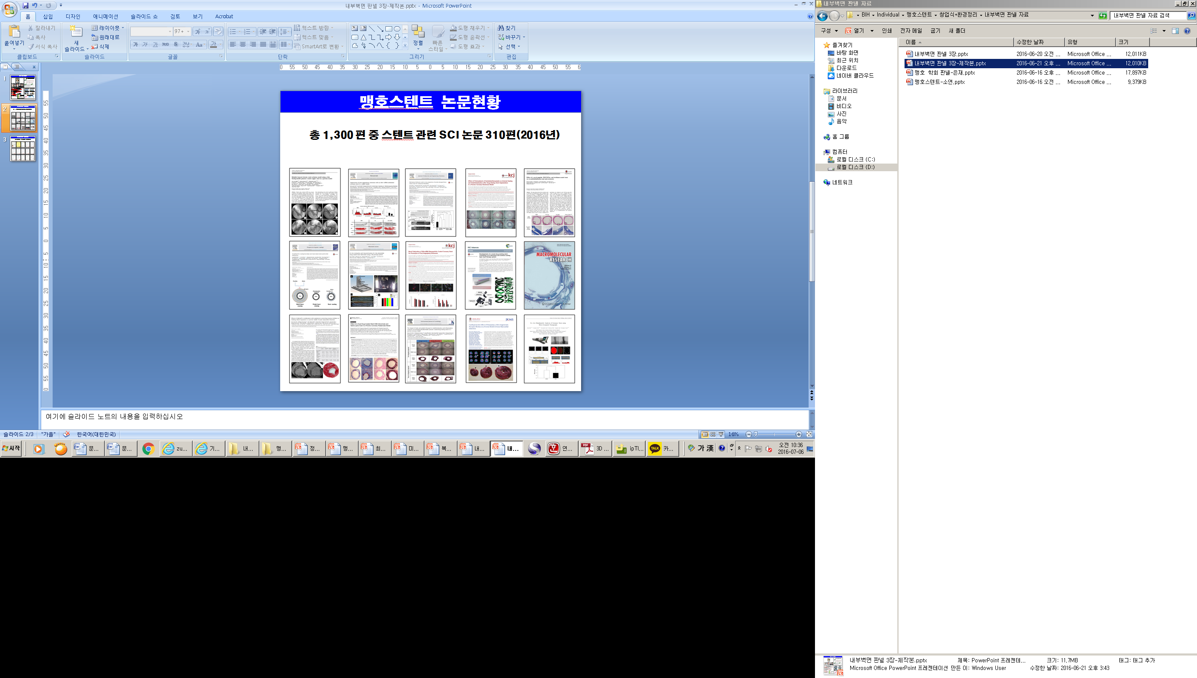
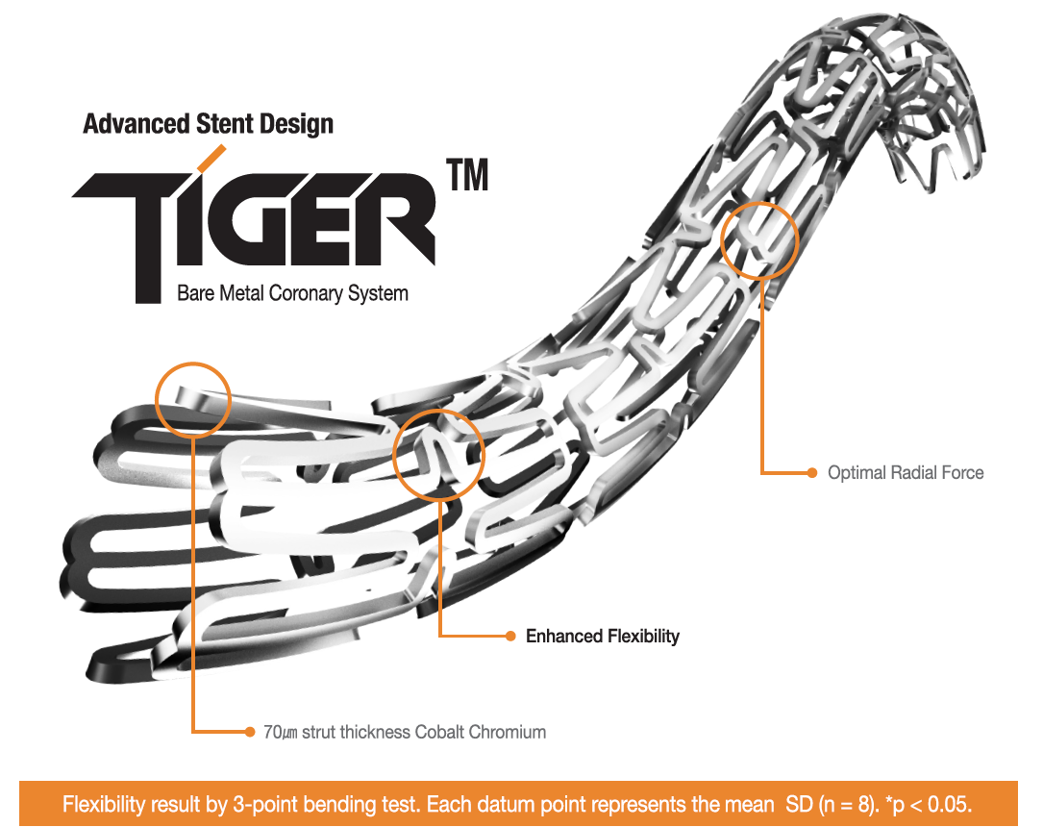
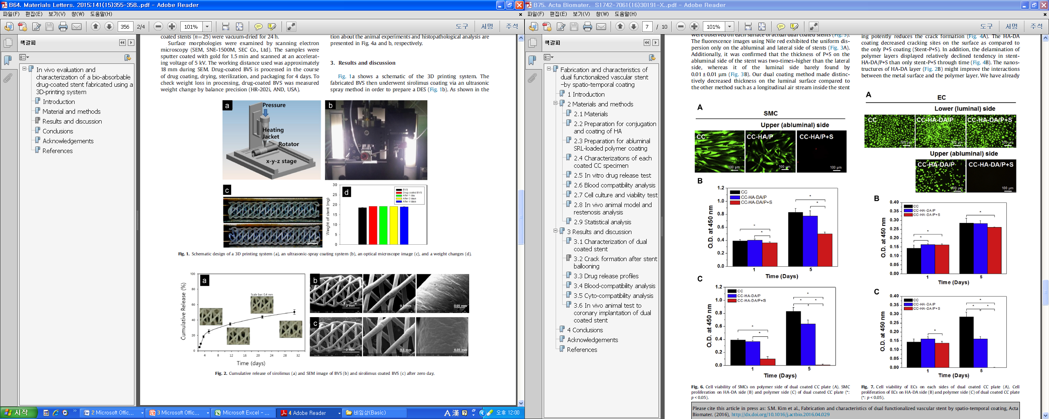
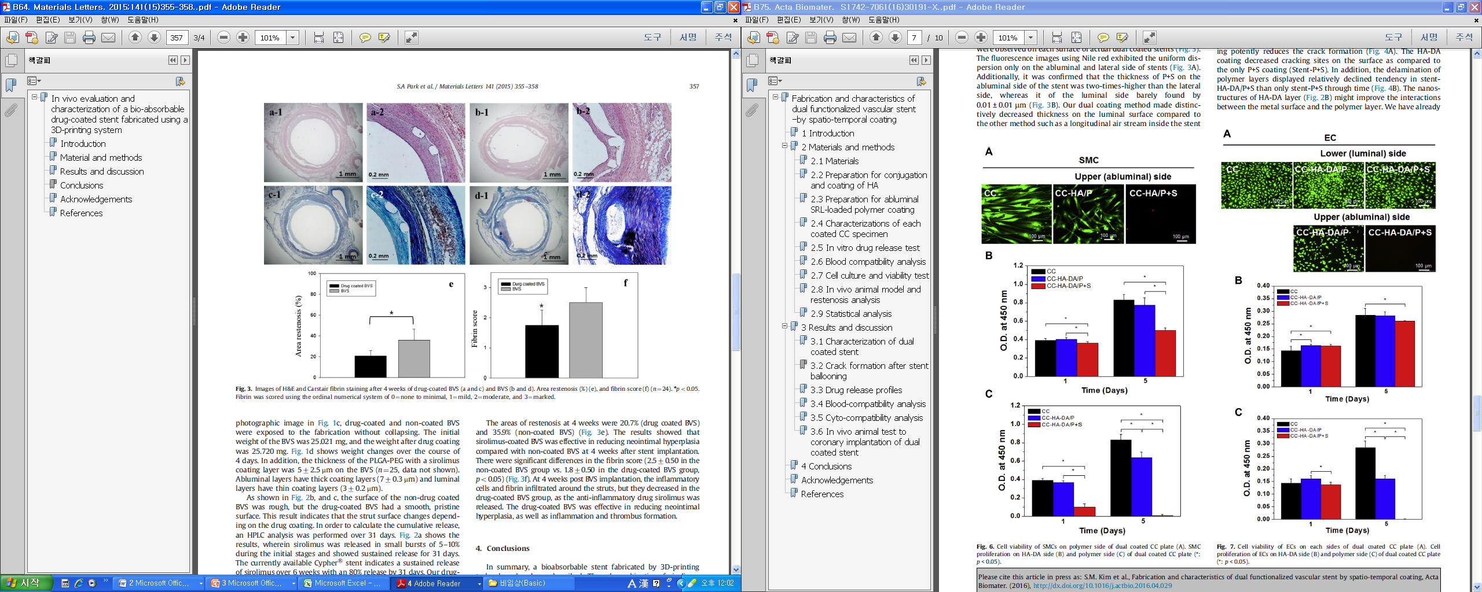
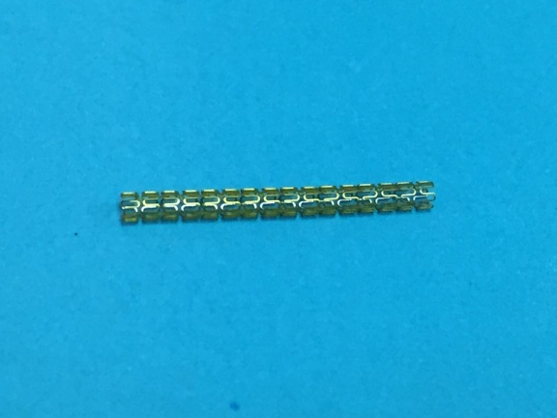
Korea cardiovascular stent research institute
CG Bio Inc.
Polymer-free NTiO₂ EES
BVS
- First in the world, US Patent
- Novel polymer-free technology
- Korea FDA approval in progress
- To be released in 2017
Korea FDA approved
Clinical use since Jan 2016
Superior flexibility
- 3D Printing technology
- PCL scaffold coated with sirolimus mixed with
PLGA and PEG
- Pre-clinical animal study

Slide 23
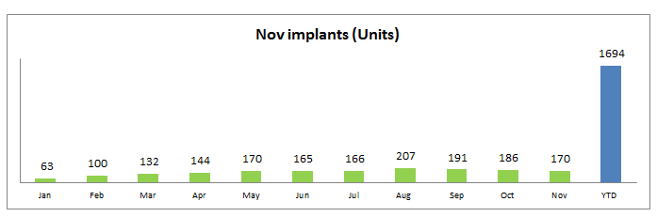
ABSORB Launching Progress in Korea
  ABSORB is reimbursed from JAN 1st, 2016 in Korea
  Until November/2016, total 1694 units of BVS implants
  More than over 80% BVS usage from Top 20 Hospitals.
7 subacute scaffold thromboses were observed by possible mechanism of underexpansion /malapposition or early D/C of DAPT. Half of them were implanted with 2.5 mm(18-28 mm) in patients with AMI(NSTEMI or STEMI)

Slide 24
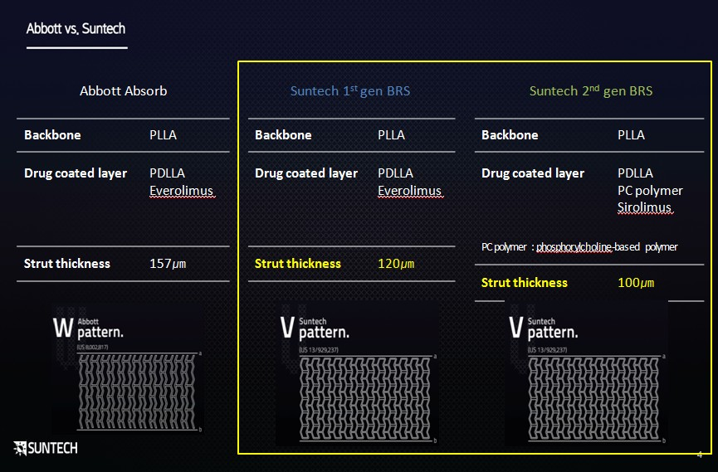
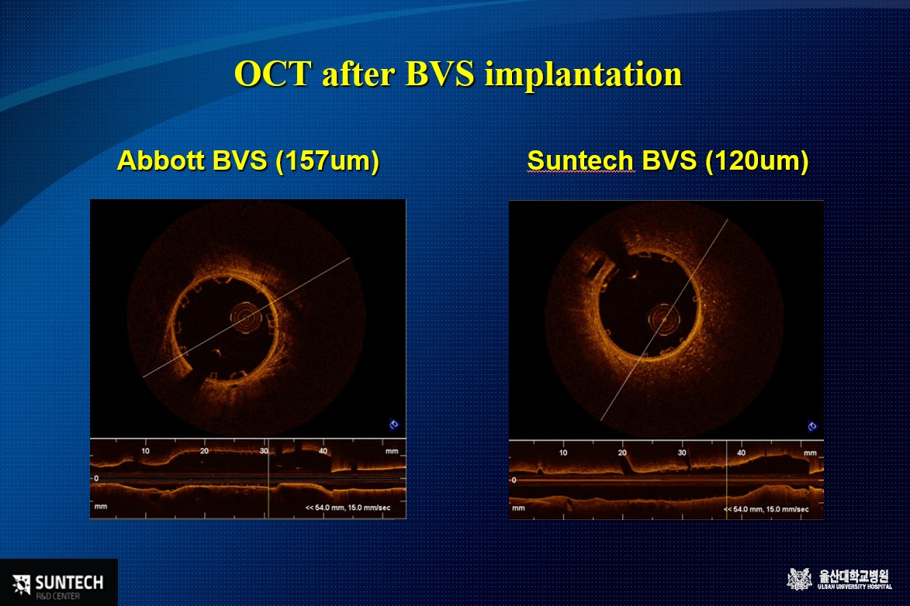
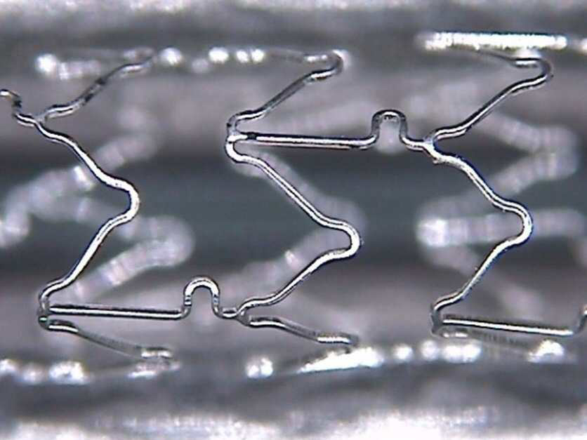
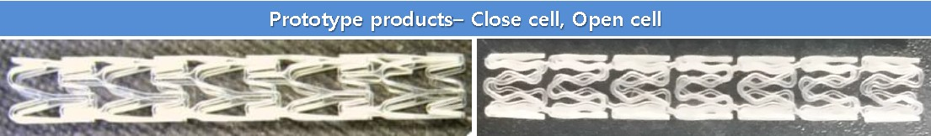
Current Status of the development of BVS in Korea
Korea cardiovascular stent research institute
- 3D Printing technology
PCL scaffold coated with sirolimus mixed with PLGA and PEG
- Pre-clinical animal study
Drug
Coated
BVS
BVS
CNUH data. Materials Letters 2015;141:355-8
New Bioresorbable Drug-Eluting Mg Stent
CNUH data. Korean Patent 10-2015-0052750

Slide 25
Summary
In Korea, a market of medical equipment for interventional cardiology is rapidly growing over the years.
Korea made coronary DES’s developed with modern design and techniques must be verified with well designed clinical trials.
Fortunately big companies in Korea take small stent manufacturers and have potentials to invest in the near future.
Industry academic relationship is becoming more active.
Recently, BRS’s having different design from ABSORB were developed and had preclinical trials.

Slide 26
Thanks for Your Attention!

